Slide 1
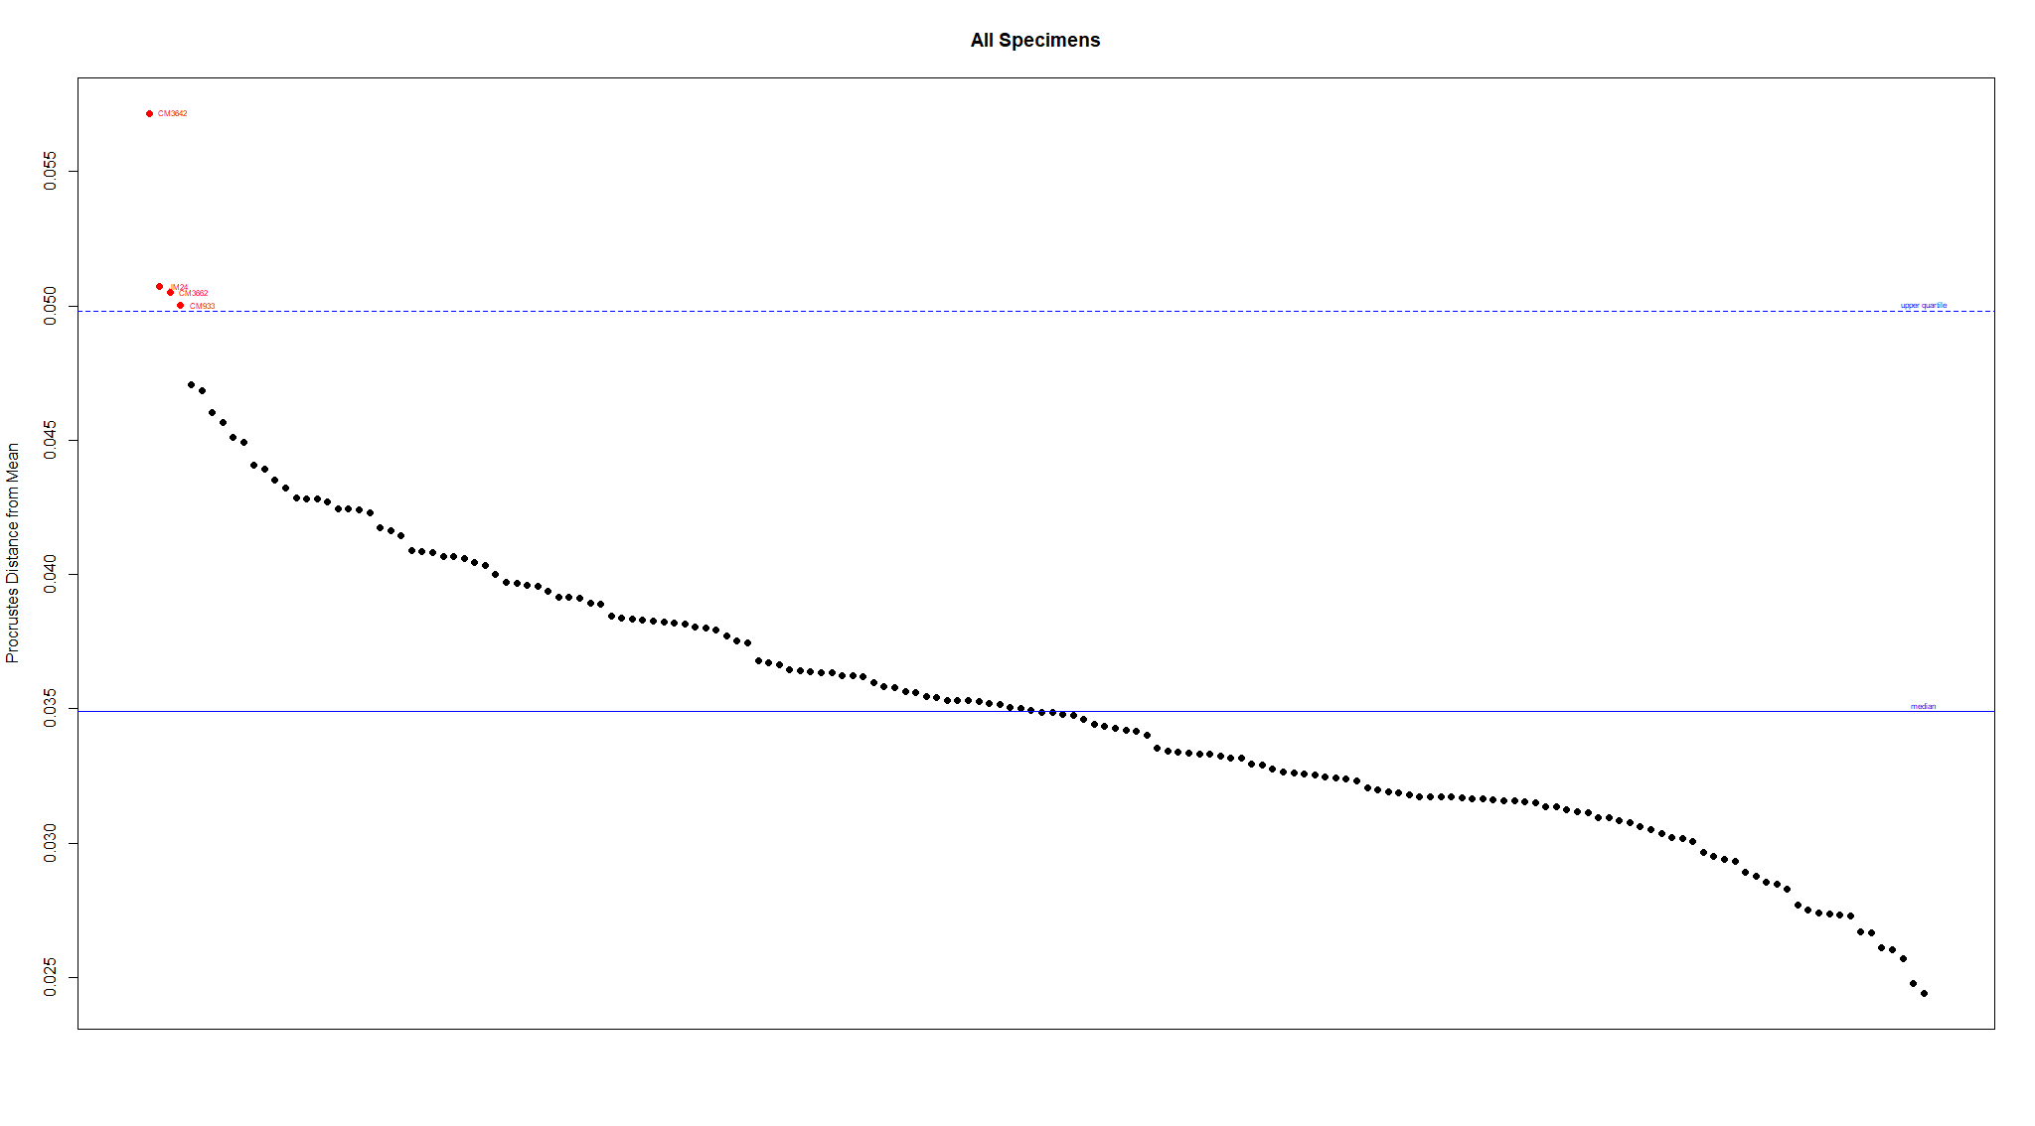
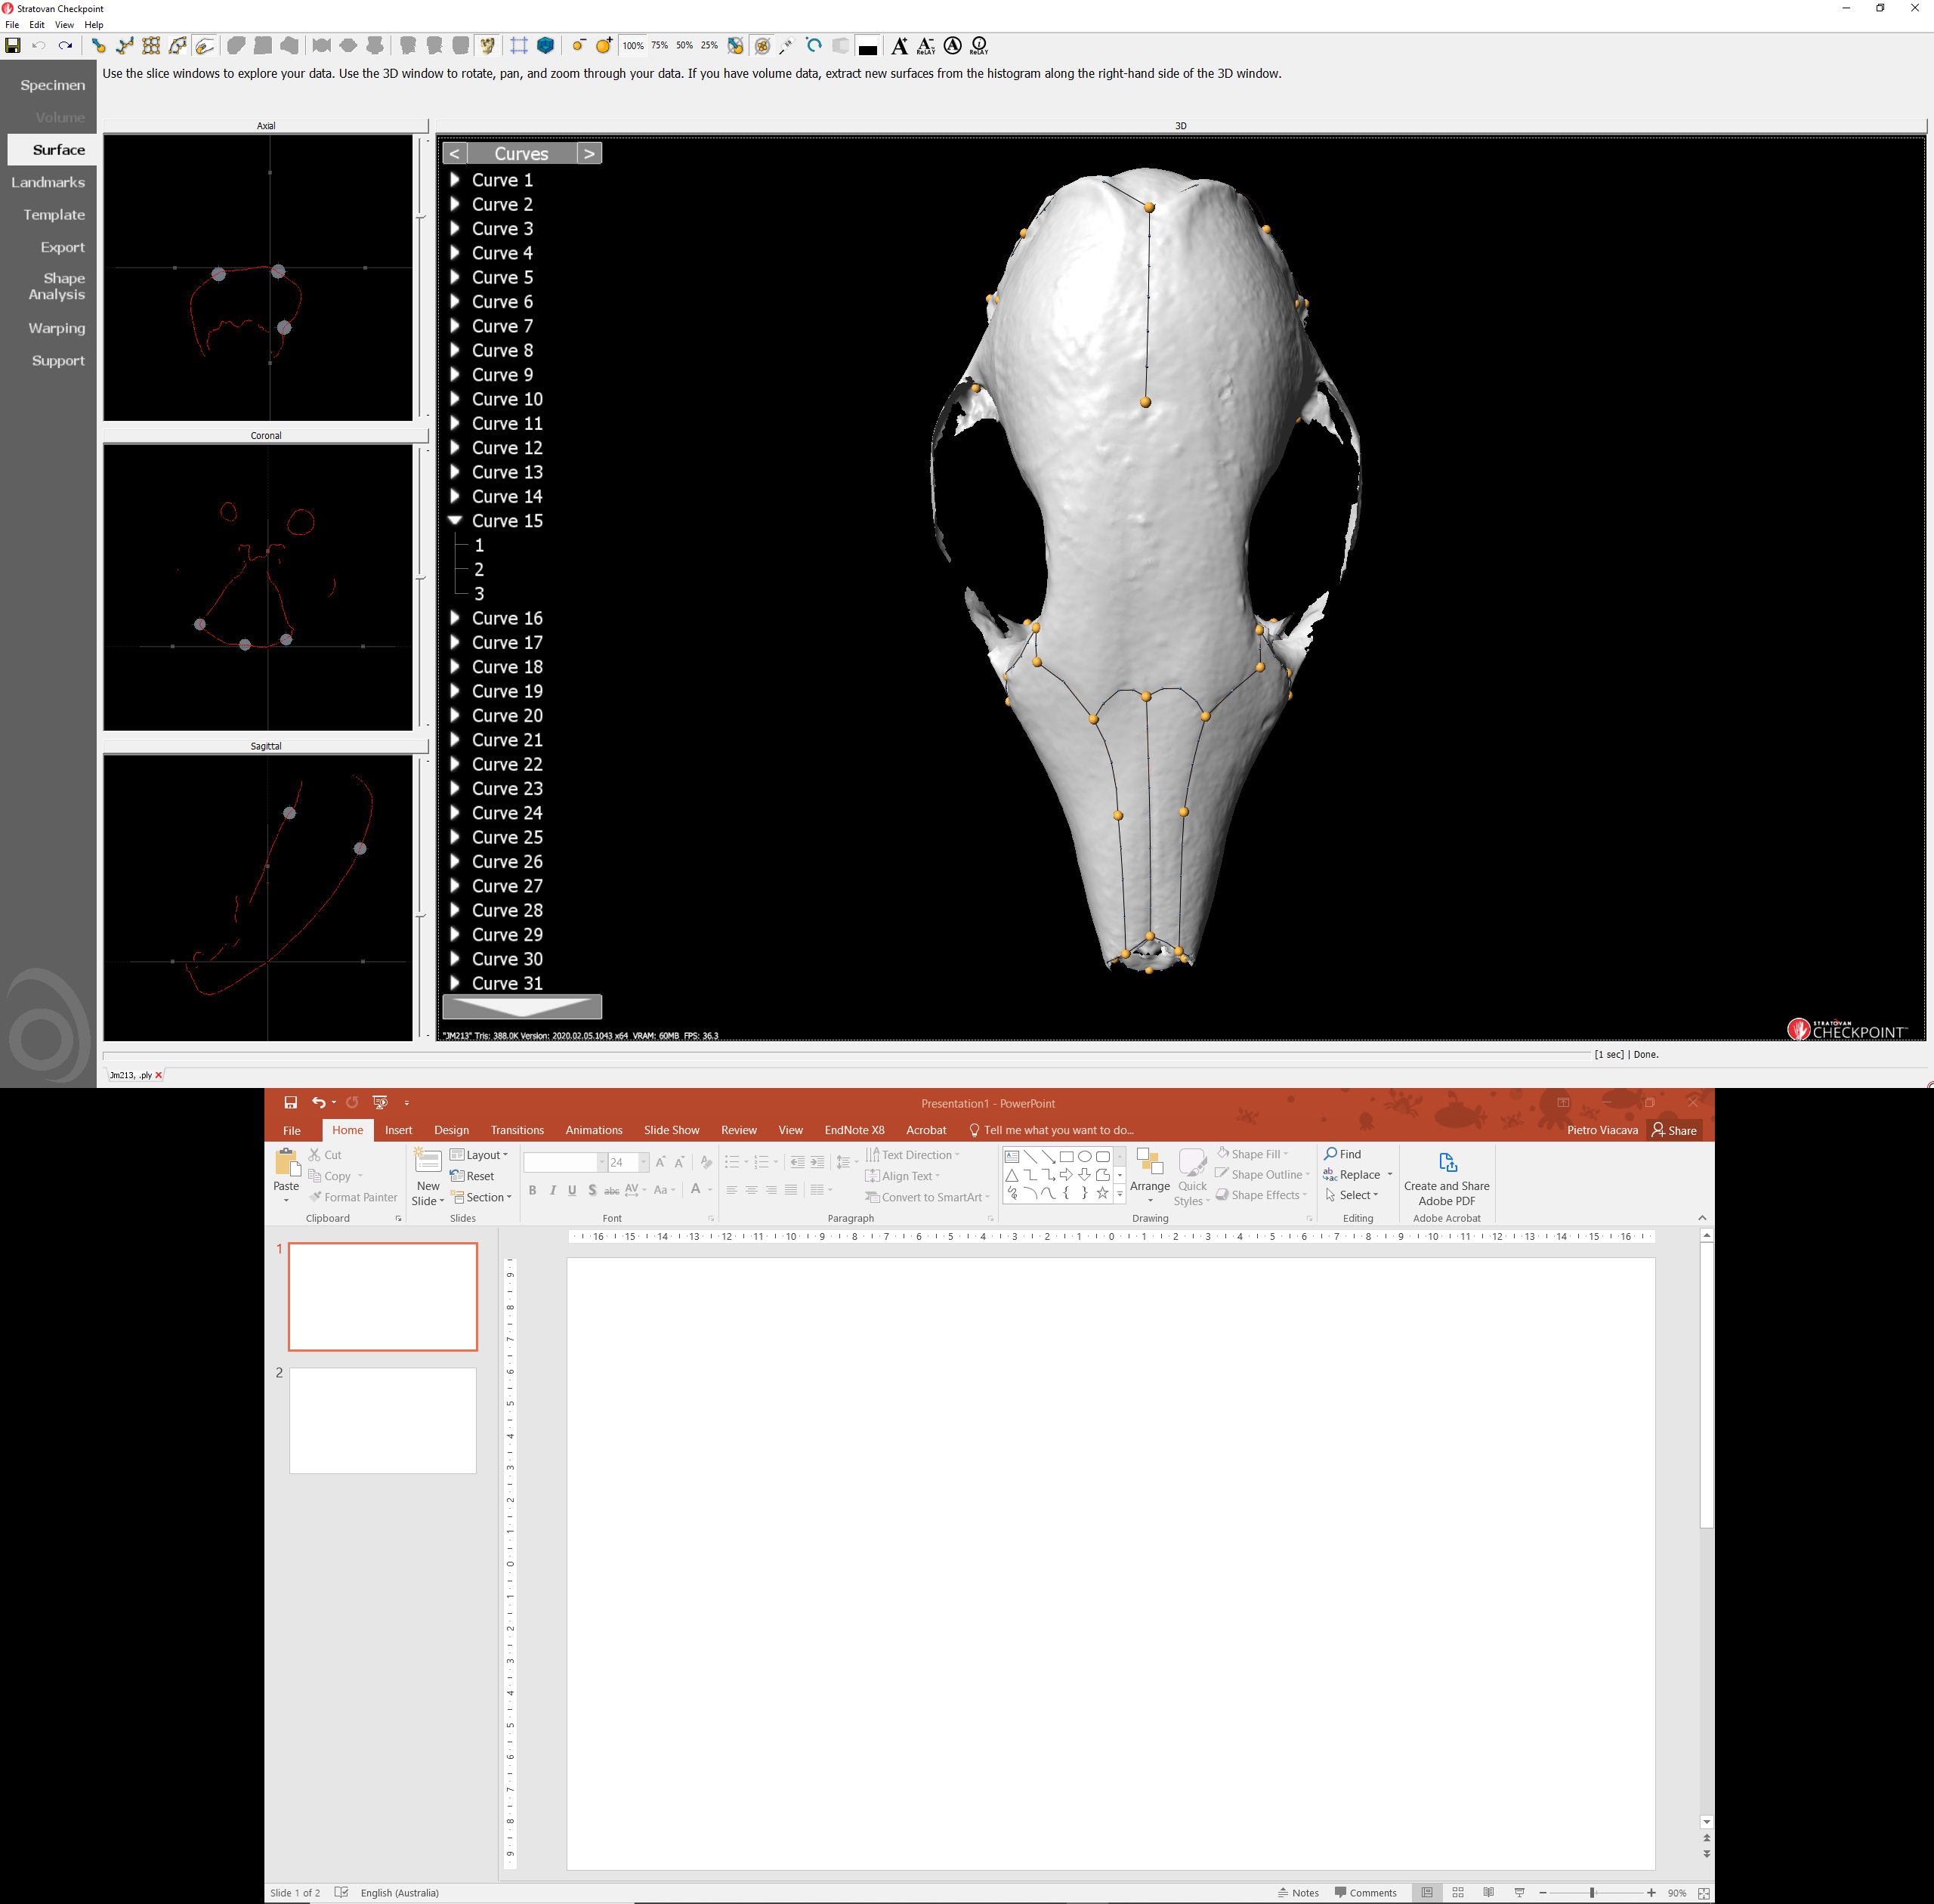
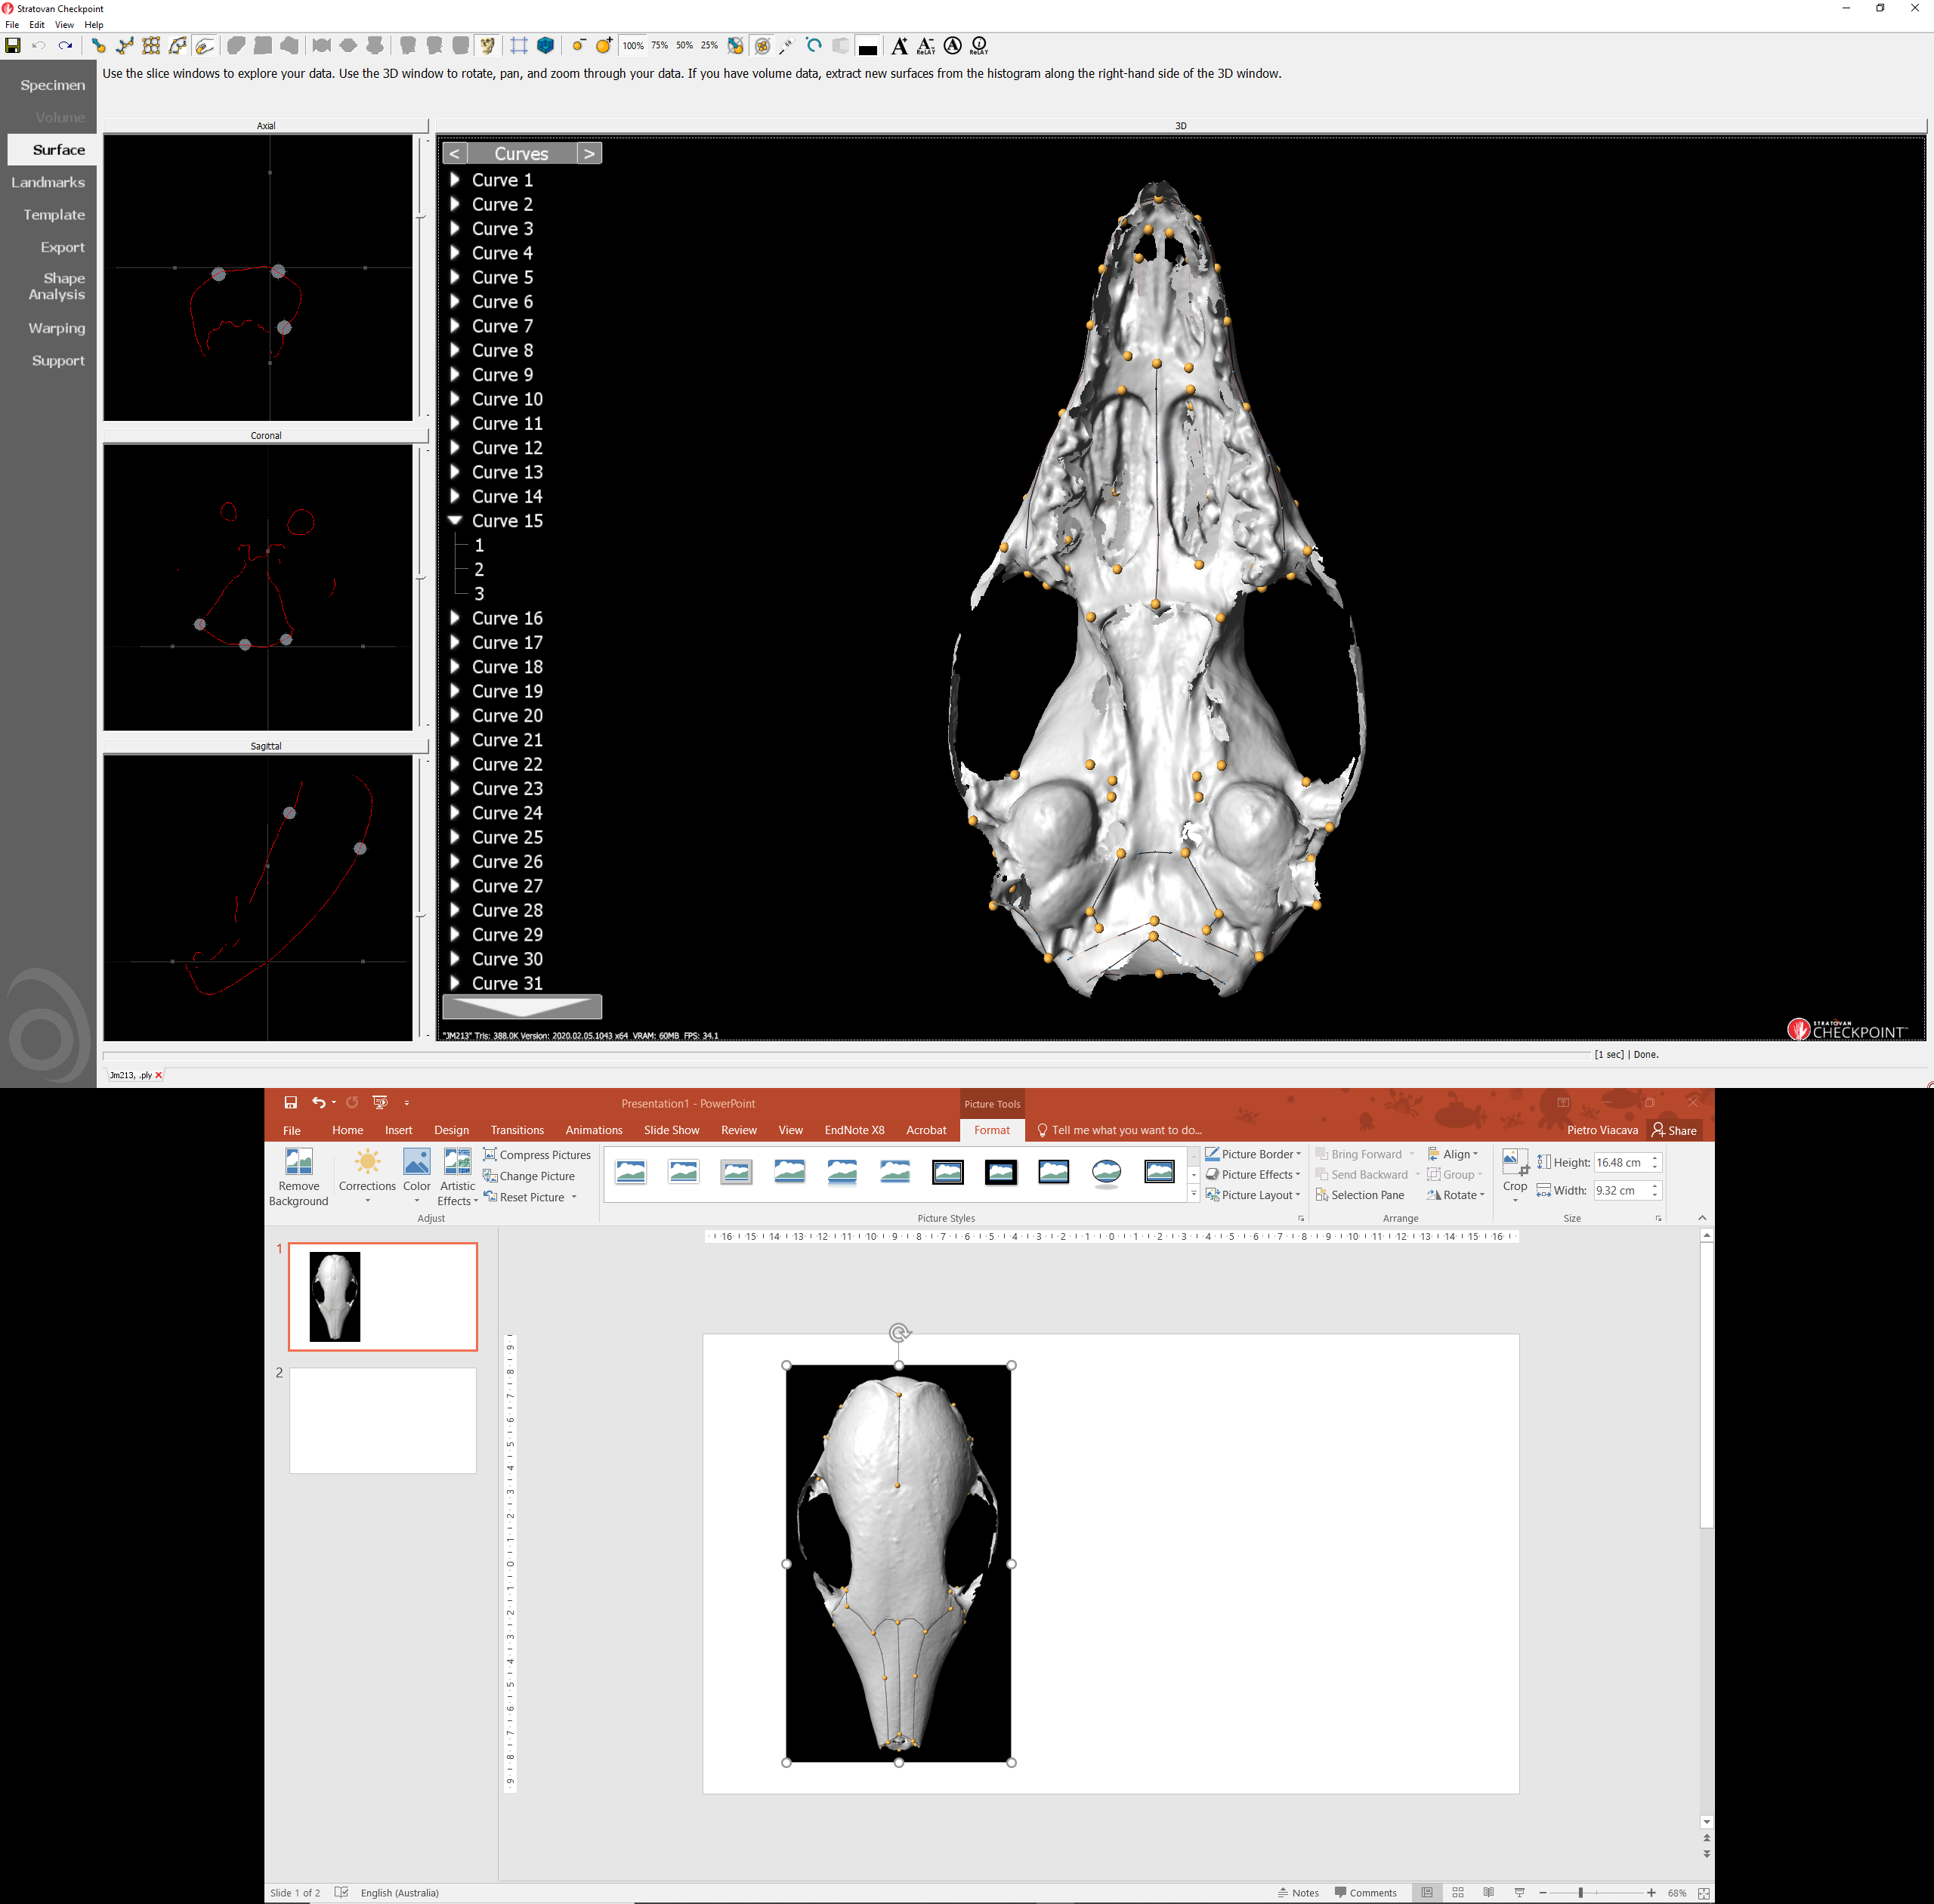
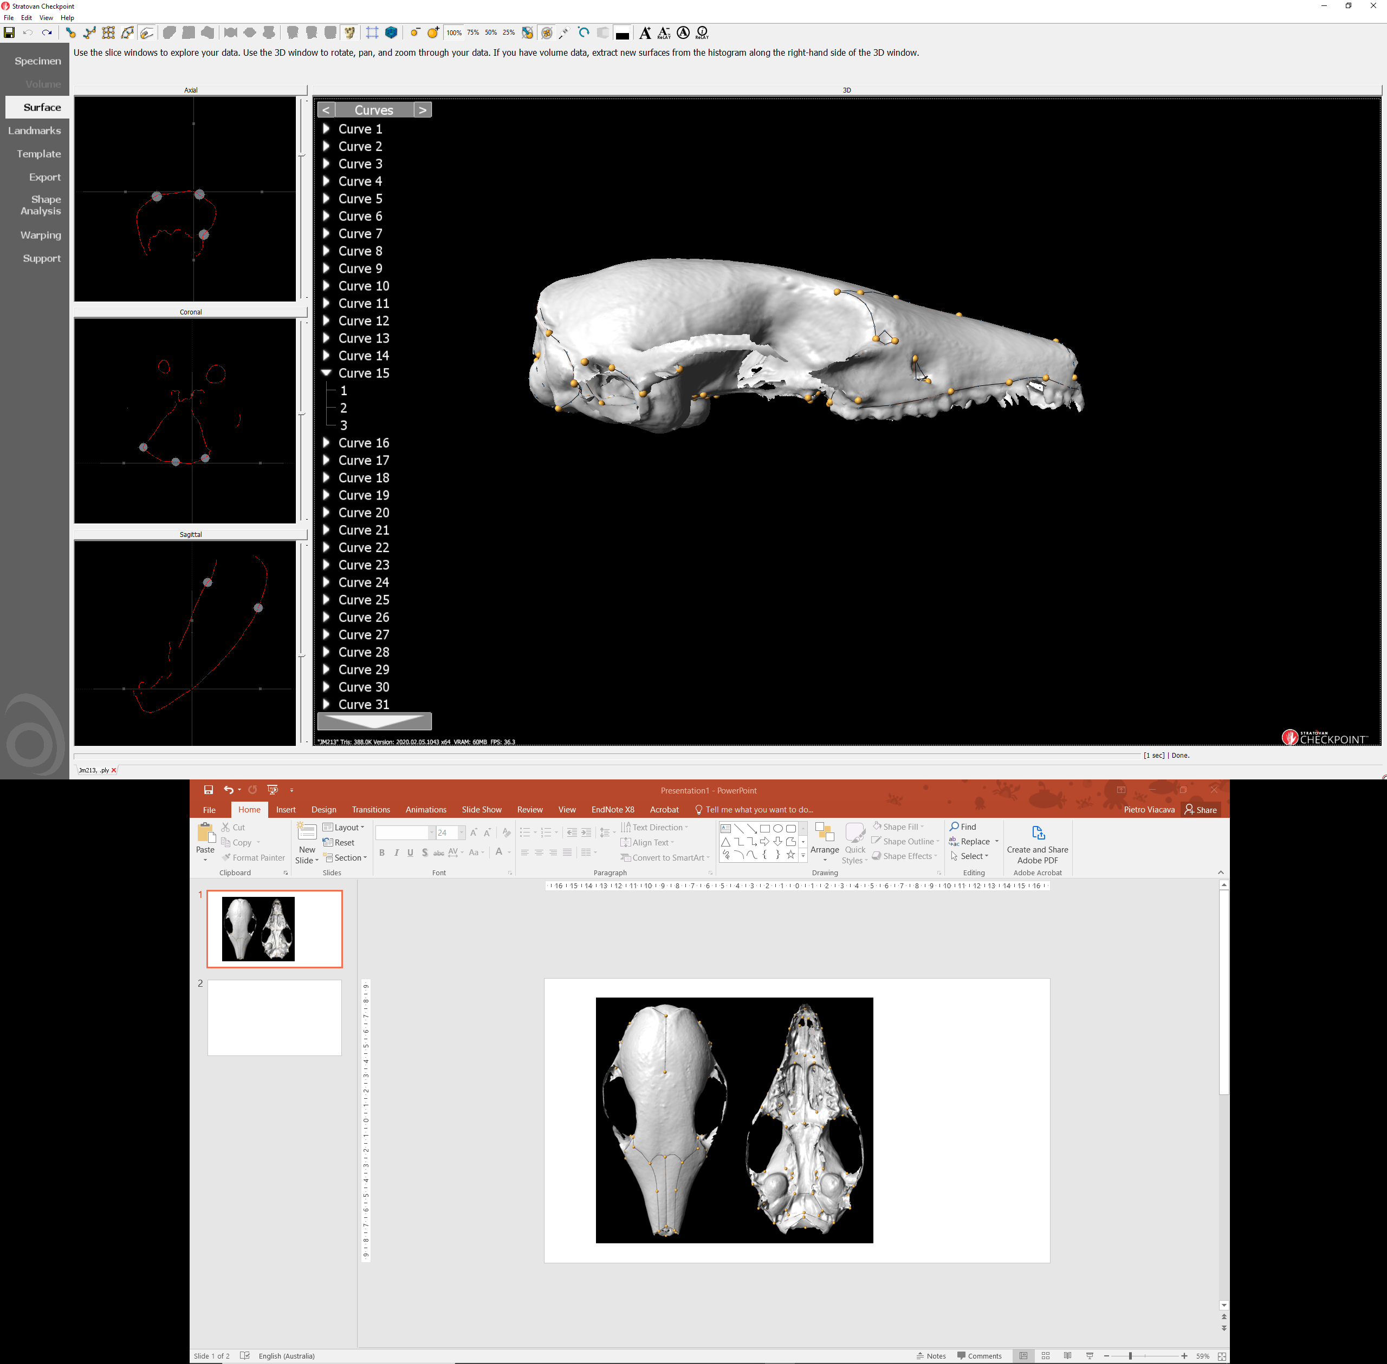
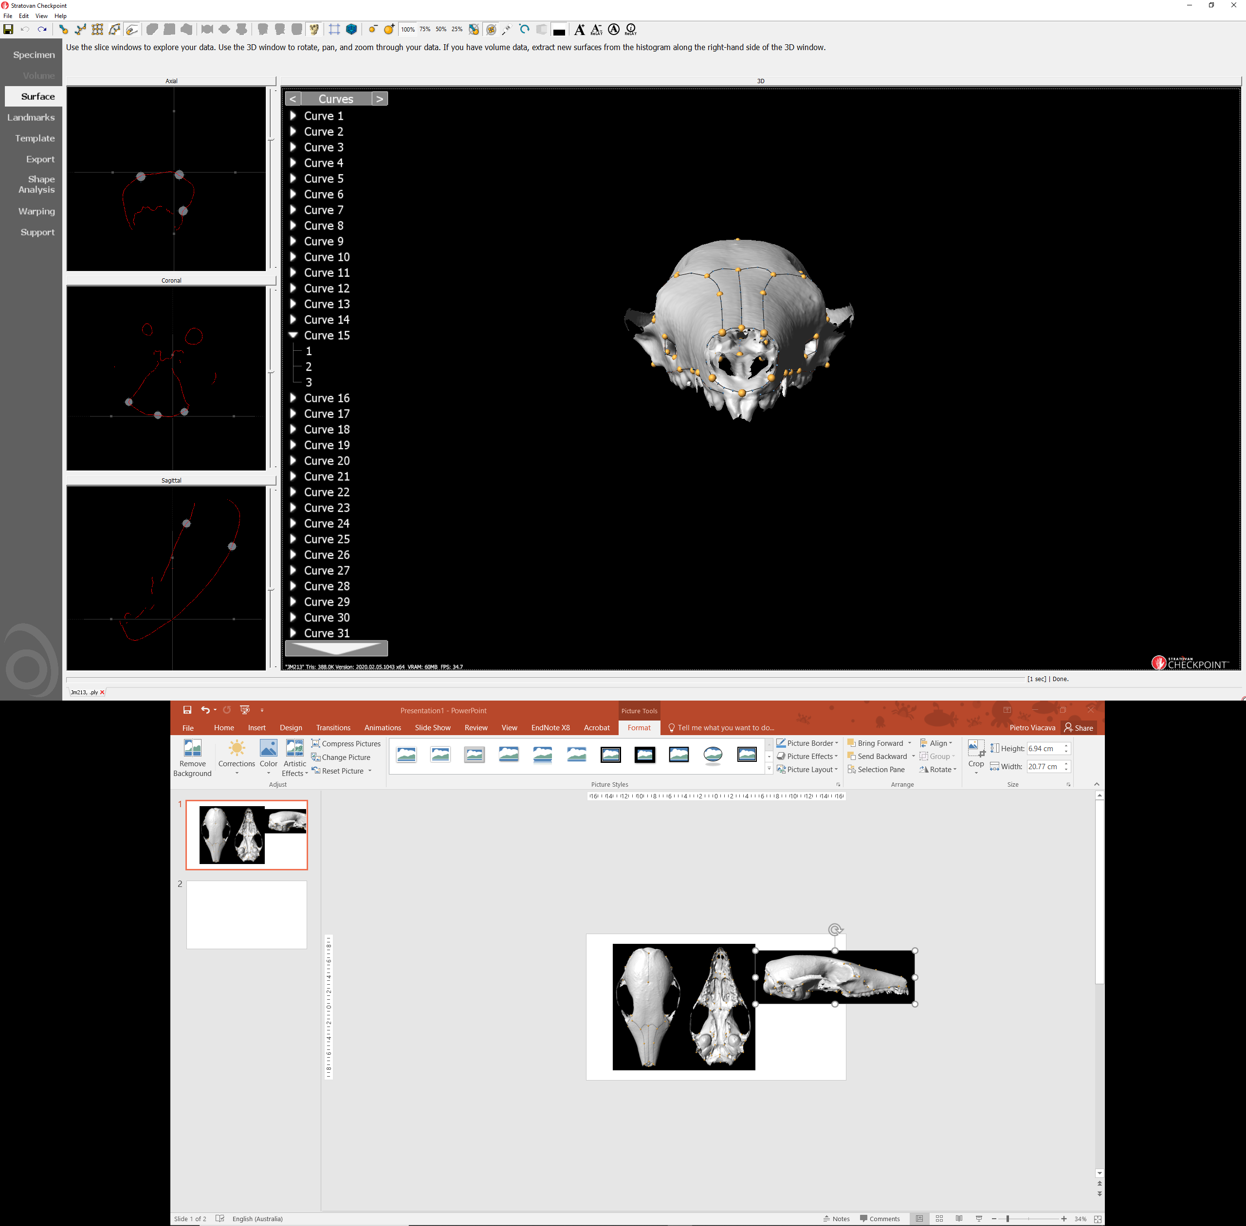
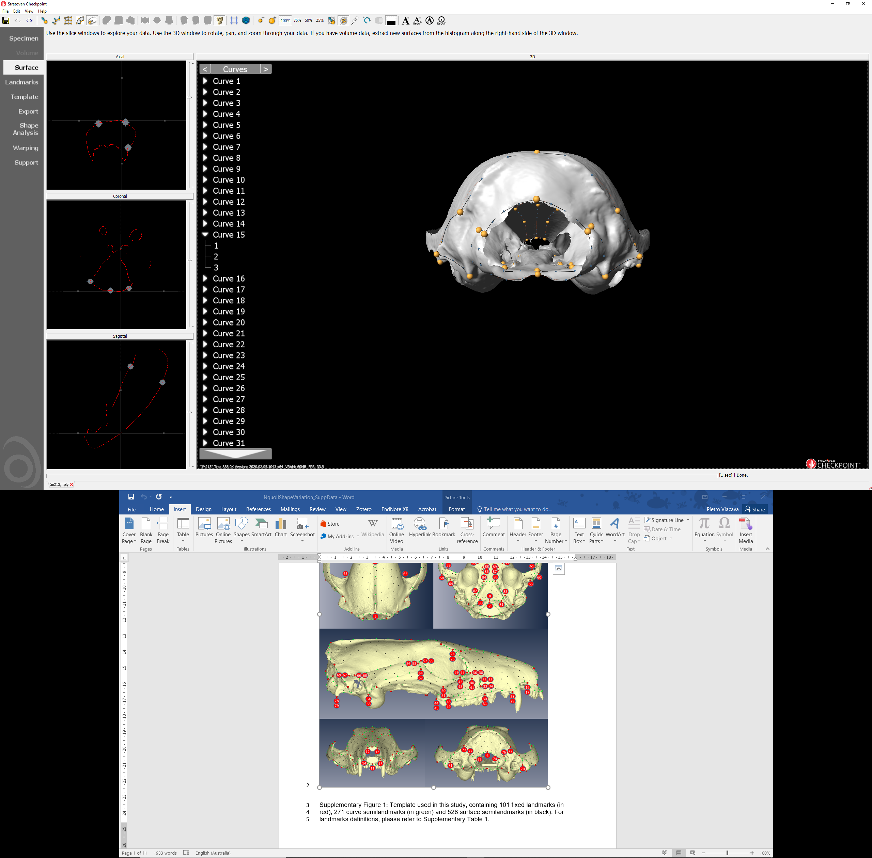
188 specimens scanned, of which:
8 were omitted from landmarking
180 specimens landmarked, of which:
6 were omitted from analysis because were juvenile
4 believed to be other species
1 outlier (Procrustes distance from mean, upper quartile)
169 specimens for analysis, of which:
68 females, 91 males, 10 unknown
67 subtropicus, 39 south stuartii, 23 north stuartii, 40 dubious (holotype)
4
81
82
79
23
21
19
18
9
80
53
24
22
77
78
54
34
33
3
48
47
36
35
30
51
50
49
32
29
25
15
13
52
45
37
41
31
27
26
16
14
59
46
38
42
28
41
39
37
75
76
38
40
42
60
23
24
73
8
74
2
20
4
21
22
19
17
18
5
19
2
20
43
71
69
70
72
30
11
1
12
32
54
58
57
53
45
67
68
44
46
41
29
31
42
52
56
55
51
17
18
63
65
7
66
64
13
10
14
60
6
59
1
59
61
6
62
60
11
12
5

Slide 2
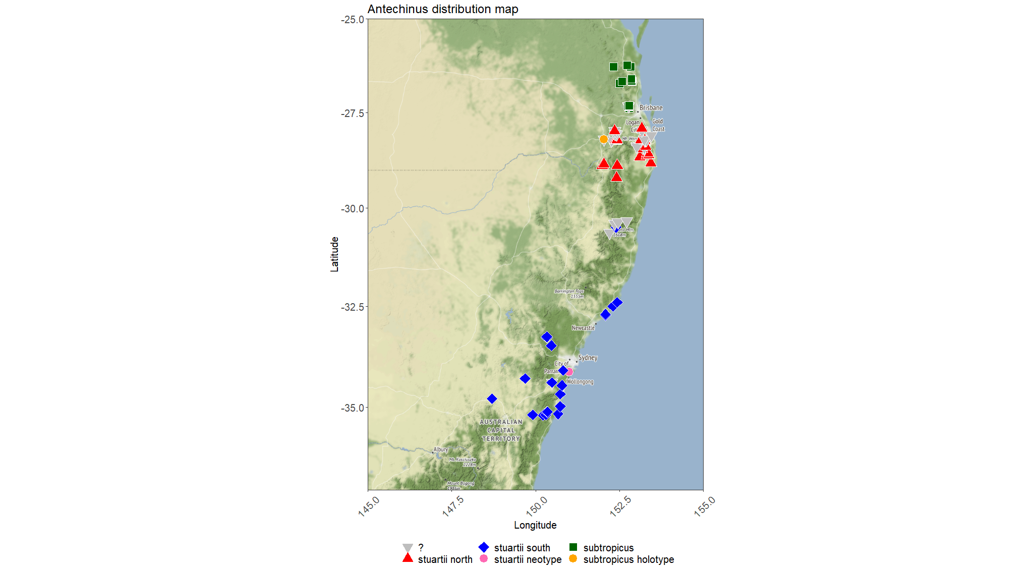
Pleistocene (2.6 Mya)

Slide 3
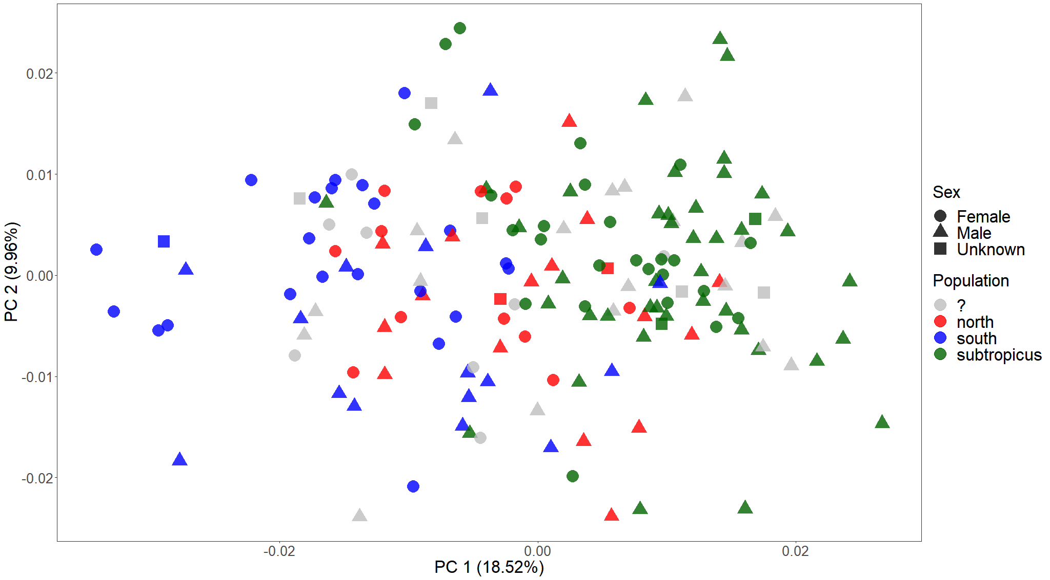
Notes:
Supplementary?

Slide 4
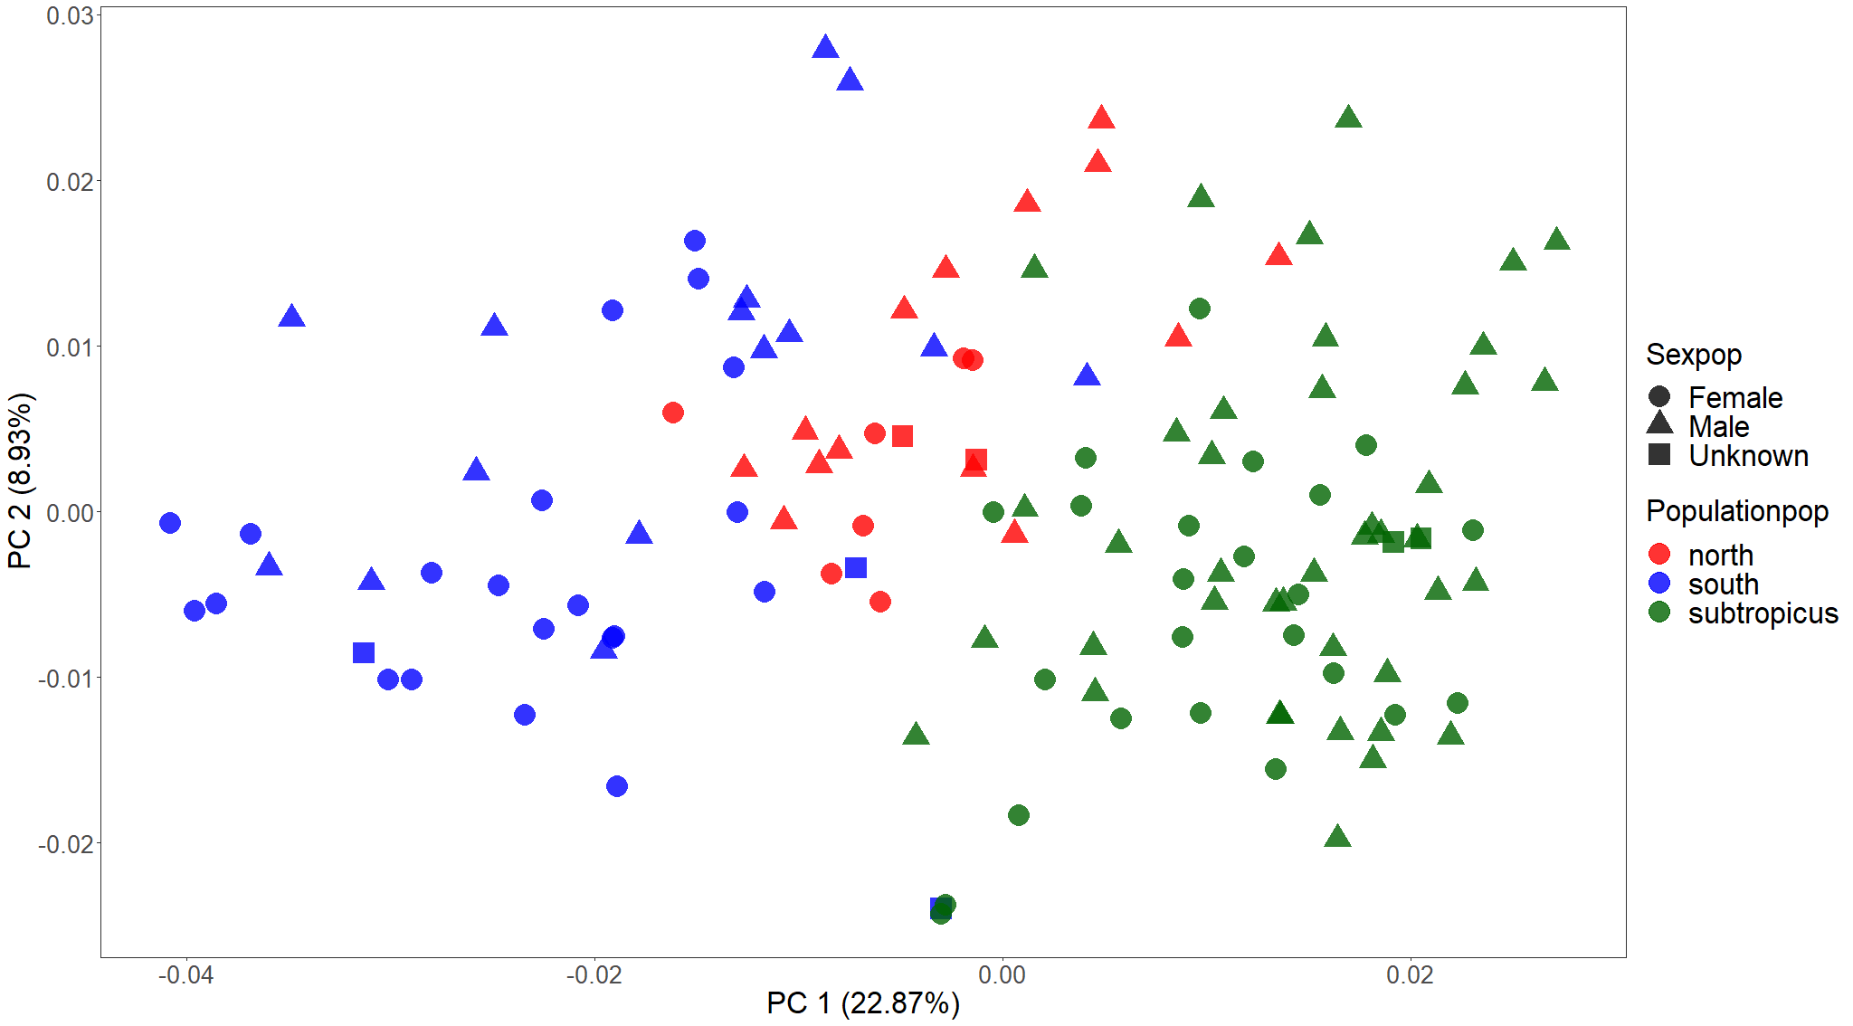
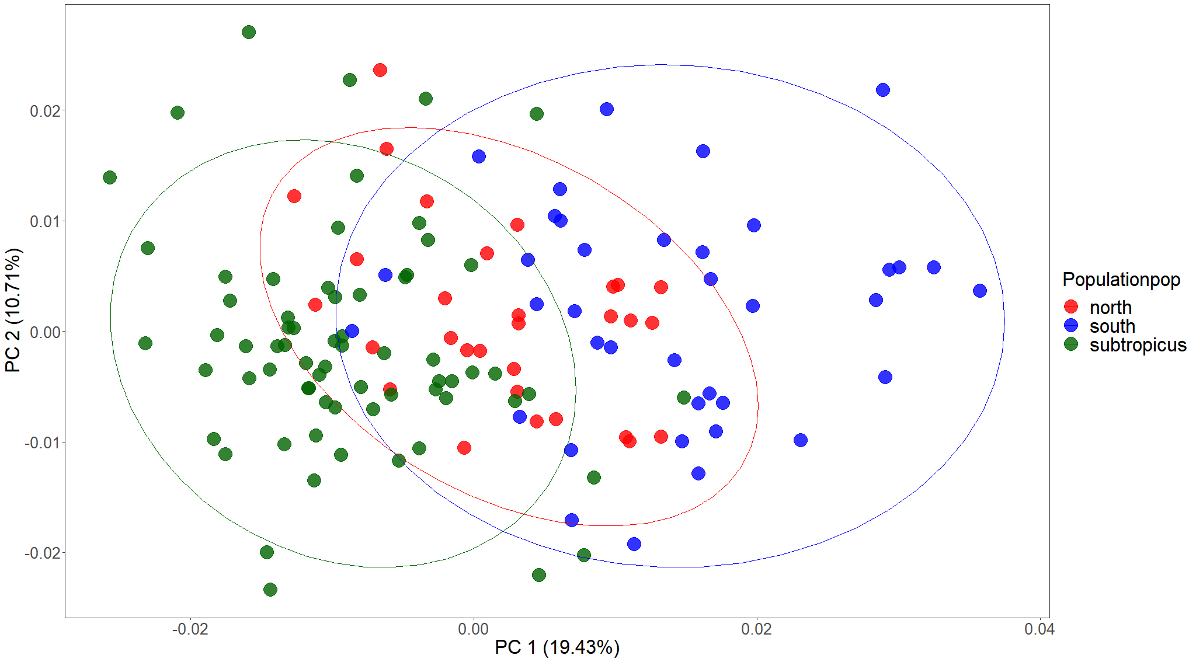
 | south | north | subtropicus
south
north | Mean shape: p = 0.001 Disparity: p = 0.725
subtropicus | Mean shape: p = 0.001 Disparity: p = 0.933 | Mean shape: p = 0.001 Disparity: p = 0.734
Procrustes ANOVA
Are populations different in shape? (shape~population)
R² = 0.143
F_{1, 127} = 11.082
p = 0.001

Slide 5
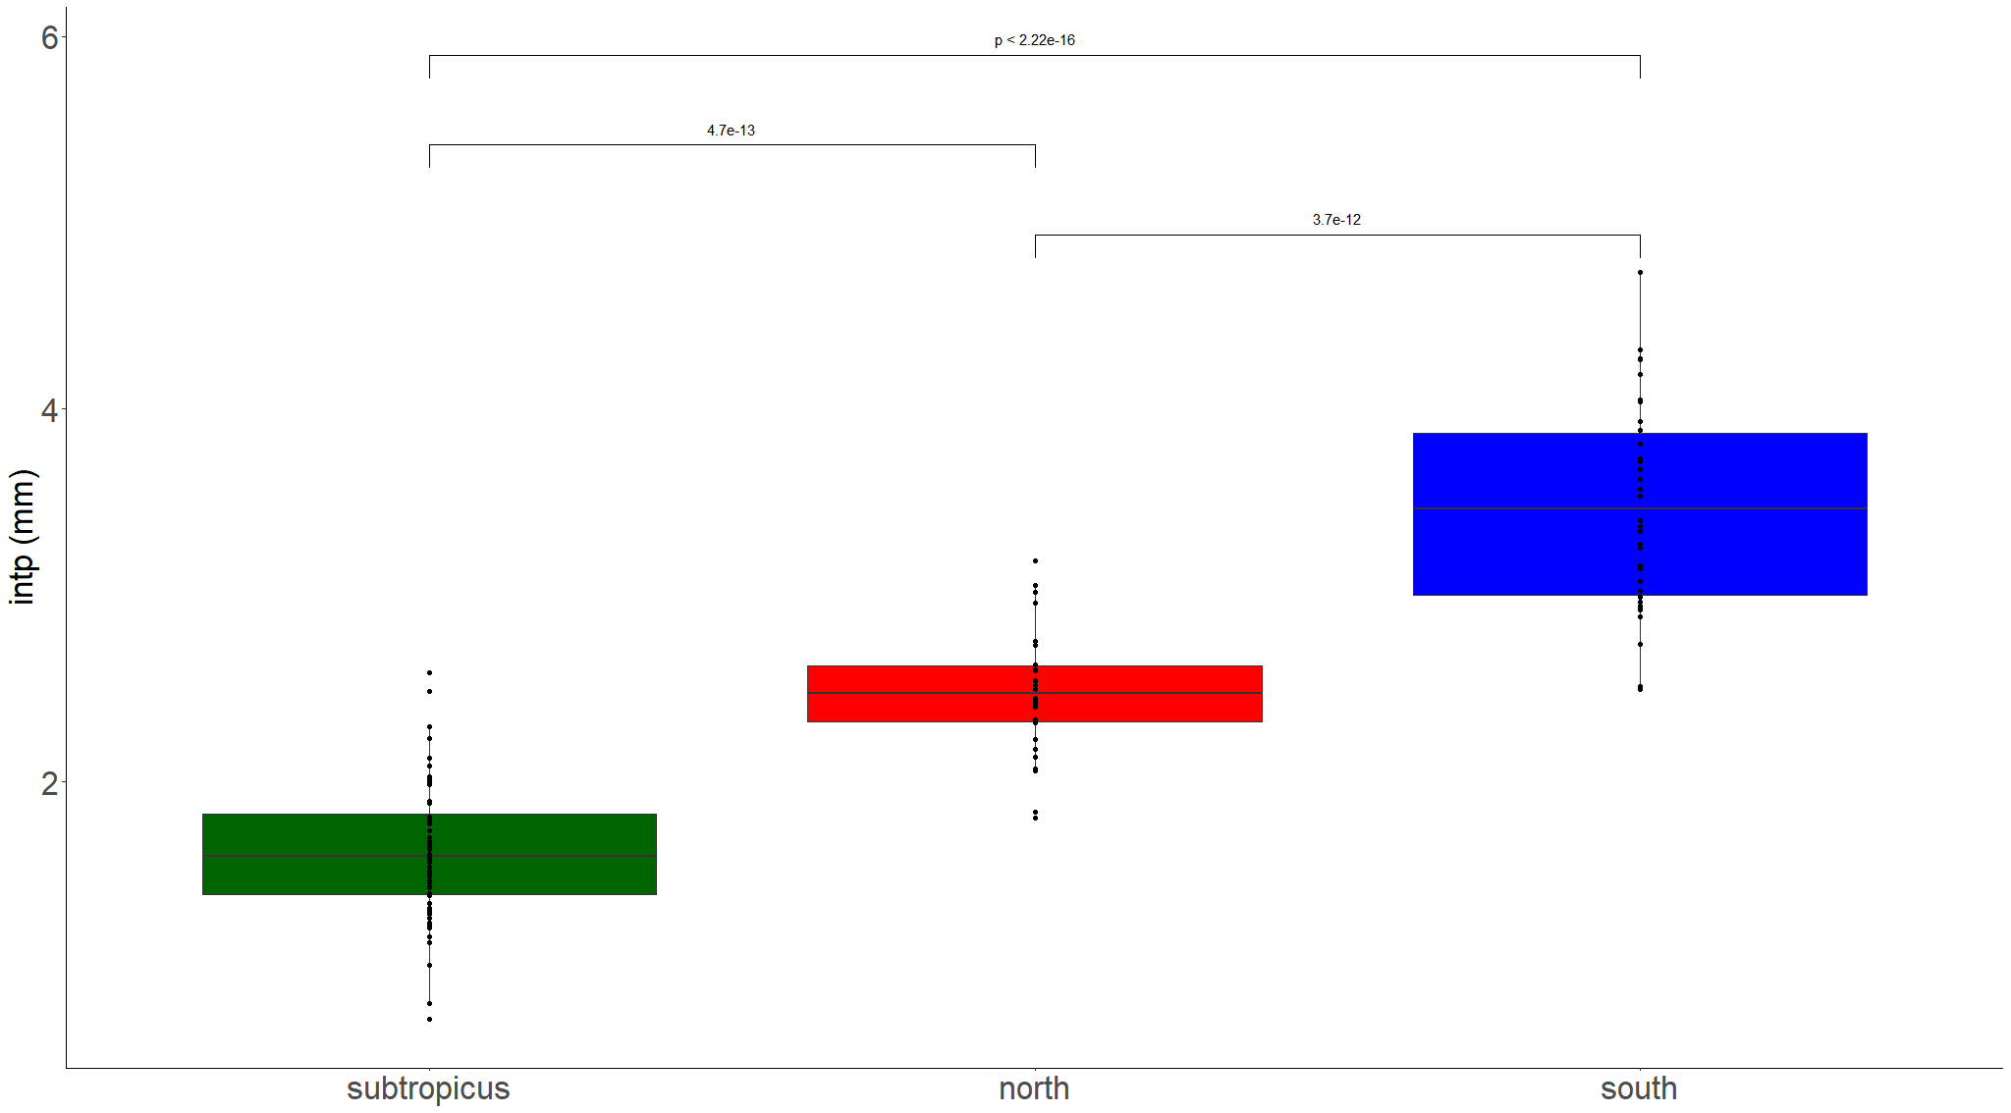

Slide 6
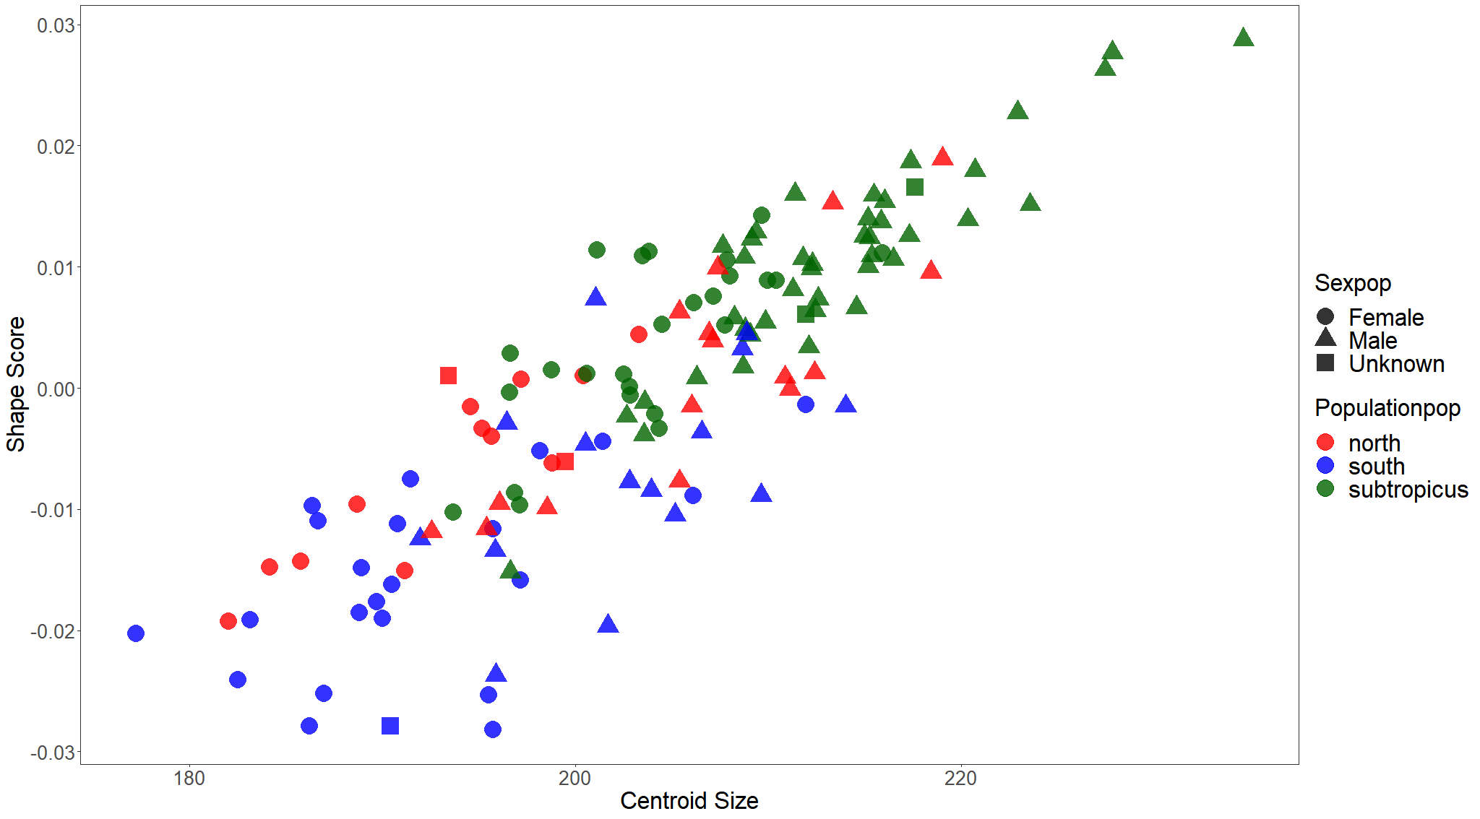
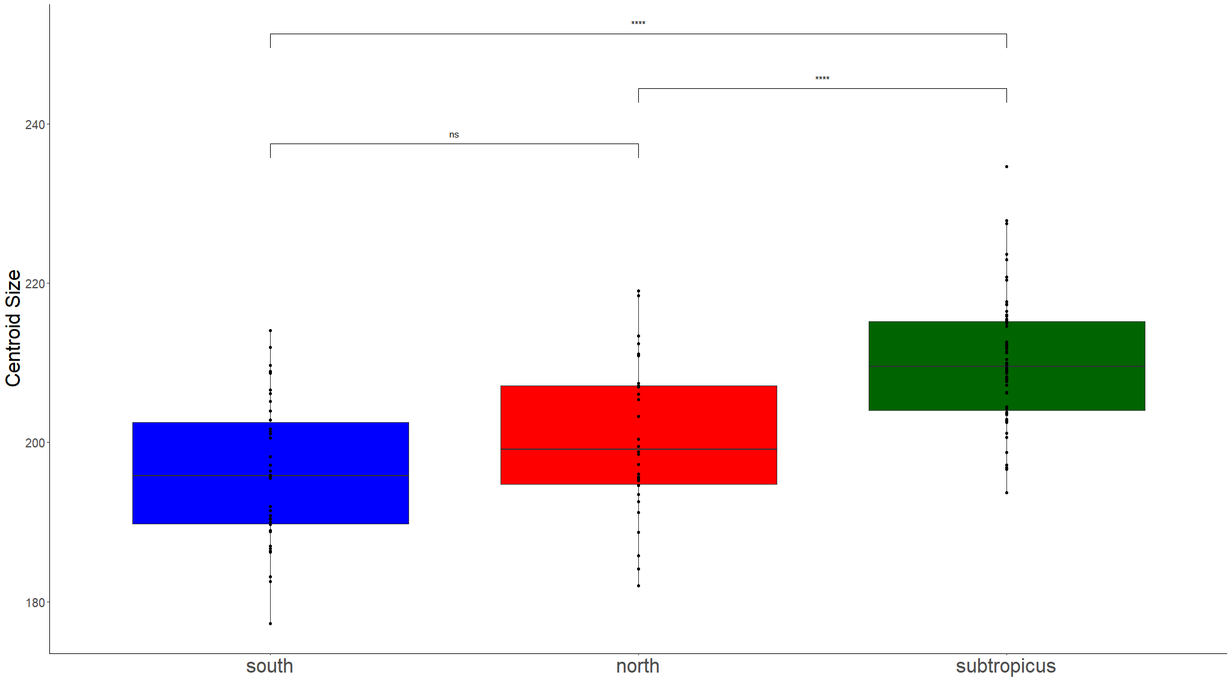
Procrustes ANOVA allometry (shape~size)
R² = 0.133
F_{1, 127} = 20.477
p = 0.001
Do they have unique allometries? (shape~size*population)
R² = 0.012
F_{2, 123} = 1.01
p = 0.429
Adjusting for size, are populations different in shape? (shape~size+population)
R² = 0.085
F_{2, 125} = 7.17
p = 0.001
Population identity as a predictor of size variation
Adj. R² = 0.338
F_{2, 126} = 33.925
p = 0.001

Slide 7
Response variable | Predictor variable | Question | SS | R² | F | Pr (>F) | Interpretation
Size | Latitude | Is latitude covarying with size in this dataset? | 3735.5 | 0.195 | 40.29 | 0.001 | Clear effect.
 | Latitude within each population | Is latitude covarying with size within each population? | South: 104.32 North: 303.04 Sub: 4.7 | South: 0.035 North: 0.111 Sub: 0.001 | South: 1.311 North: 1.08 Sub: 0.073 | South: 0.261 North: 0.061 Sub: 0.813 | No clear effect.
 | Longitude | Is longitude covarying with size in this dataset? | 3428.9 | 0.179 | 36.261 | 0.001 | Clear effect.
 | Longitude within each population | Is longitude covarying with size within each population? | South: 21.16 North: 485.53 Sub: 31 | South: 0.007 North: 0.178 Sub: 0.007 | South: 0.258 North: 6.07 Sub: 0.478 | South: 0.629 North: 0.027 Sub: 0.461 | No clear effect. North might have a biased sample.
Shape | Latitude | Is latitude covarying with shape in this dataset? | 0.014 | 0.093 | 17.054 | 0.001 | Clear effect
 | Latitude within each population | Is latitude covarying with shape within each population? | South: 0.002 North: 0.001 Sub: 0.001 | South: 0.07 North: 0.052 Sub: 0.025 | South: 2.705 North: 1.543 Sub: 1.667 | South: 0.001 North: 0.058 Sub: 0.039 | Only south stuartii is varying latitudinally in shape with low effect.
 | Longitude | Is longitude covarying with shape in this dataset? | 0.012 | 0.081 | 14.645 | 0.001 | Clear effect
 | Longitude within each population | Is longitude covarying with shape within each population? | South: 0.002 North: 0.001 Sub: 0.001 | South: 0.066 North: 0.051 Sub: 0.022 | South: 2.554 North: 1.494 Sub: 1.461 | South: 0.003 North: 0.09 Sub: 0.117 | Only south stuartii is varying longitudinally in shape with low effect.

Slide 8
 |  | Size |  |  |  | Shape
 | d. f. | SS | R² | F | Pr(>F) | SS | R² | F | Pr(>F)
Precipitation | 1 | 345.1 | 0.023 | 3.132 | 0.079 | 0.001 | 0.011 | 1.45 | 0.11
Precipitation seasonality | 1 | 2968.6 | 0.196 | 32.76 | <0.001 | 0.012 | 0.101 | 15.044 | 0.001
Temperature | 1 | 4117.7 | 0.273 | 50.19 | <0.001 | 0.011 | 0.098 | 14.476 | 0.001
Temperature seasonality | 1 | 1325.4 | 0.088 | 12.88 | <0.001 | 0.002 | 0.015 | 2.068 | 0.017
Elevation | 1 | 331.5 | 0.022 | 3.006 | 0.085 | 0.001 | 0.009 | 1.277 | 0.21
Distance to permanent water | 1 | 1607.1 | 0.106 | 15.947 | 0.001 | 0.006 | 0.048 | 6.695 | 0.001

Slide 9
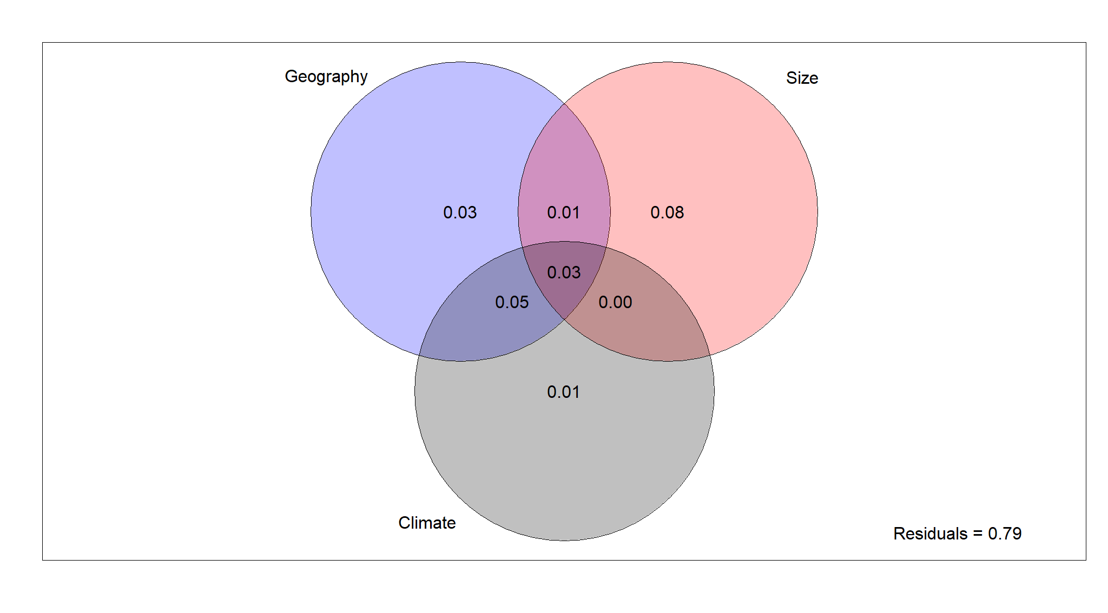
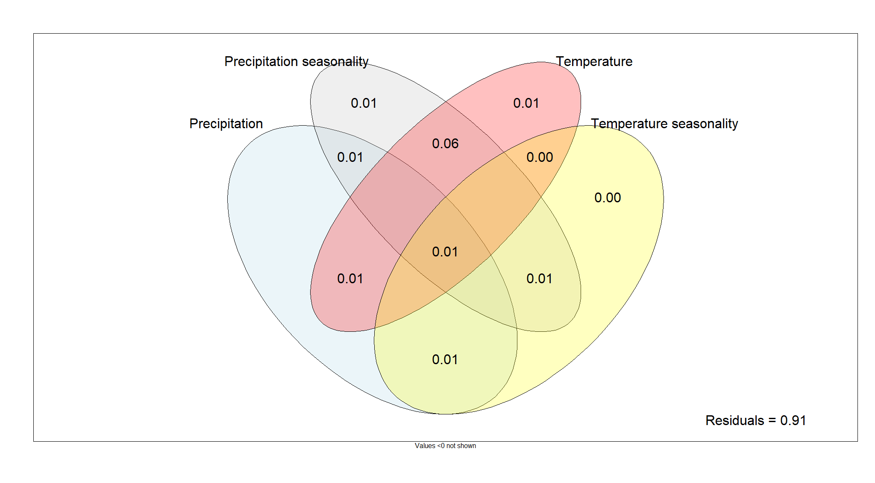

Slide 10
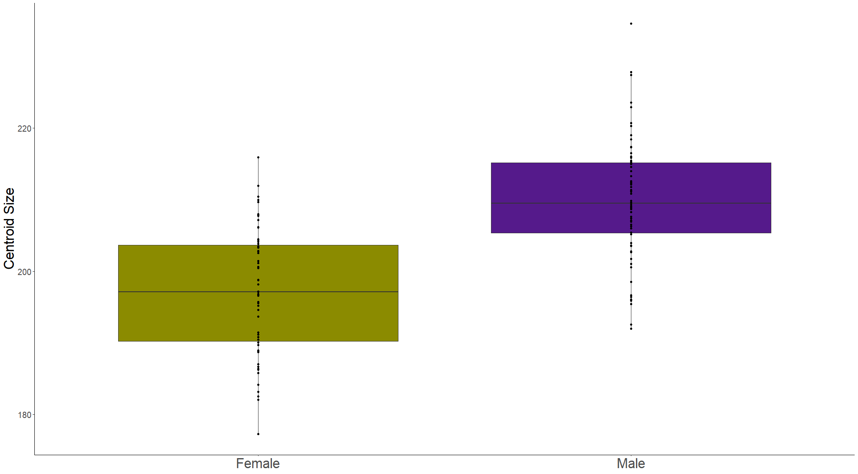
with semilandmarks
Sex as a predictor of size variation
Adj. R² = 0.352
F_{1,157} = 71.46
p < 0.001

Slide 11
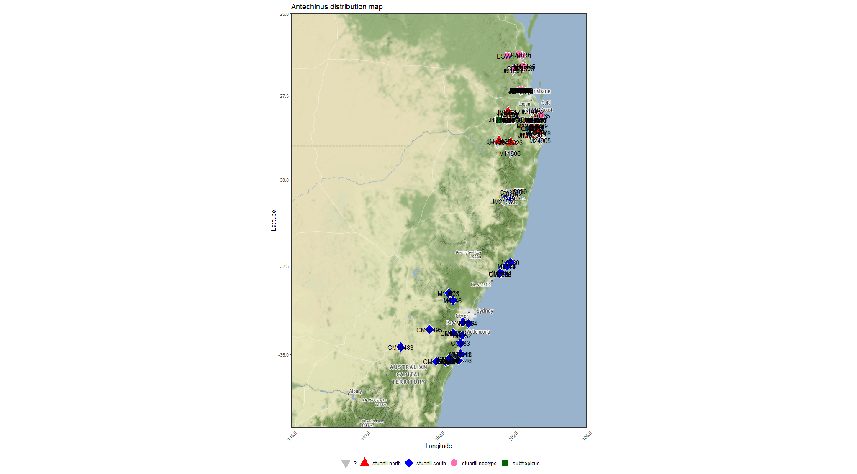

Slide 12
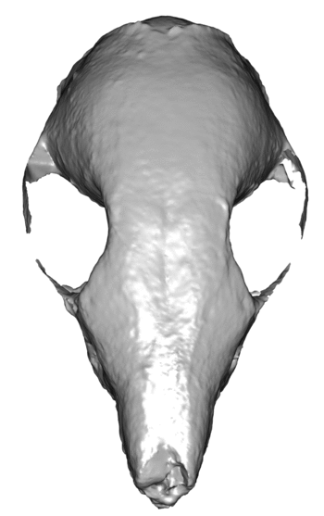
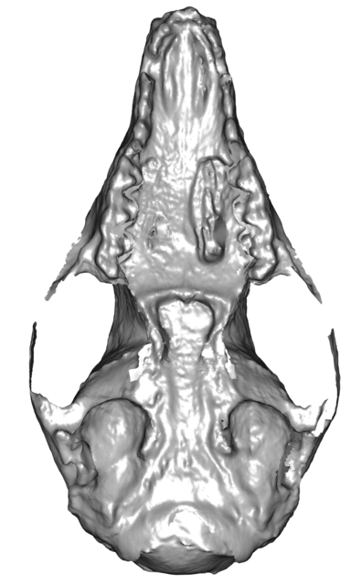
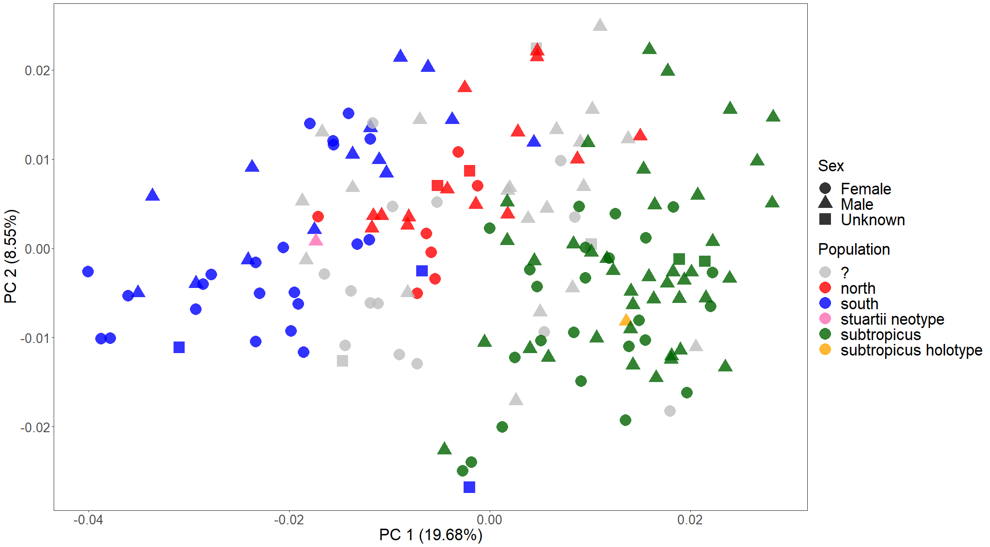
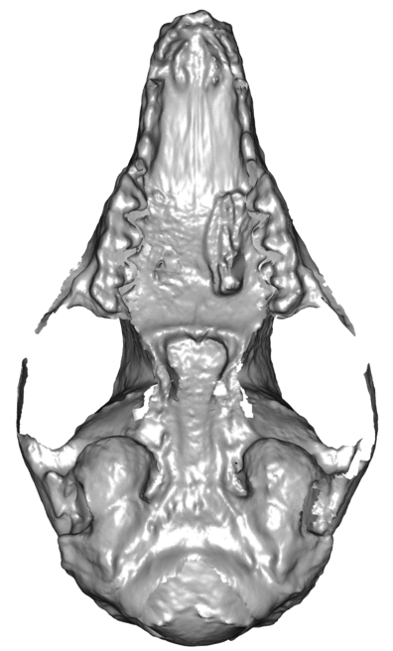
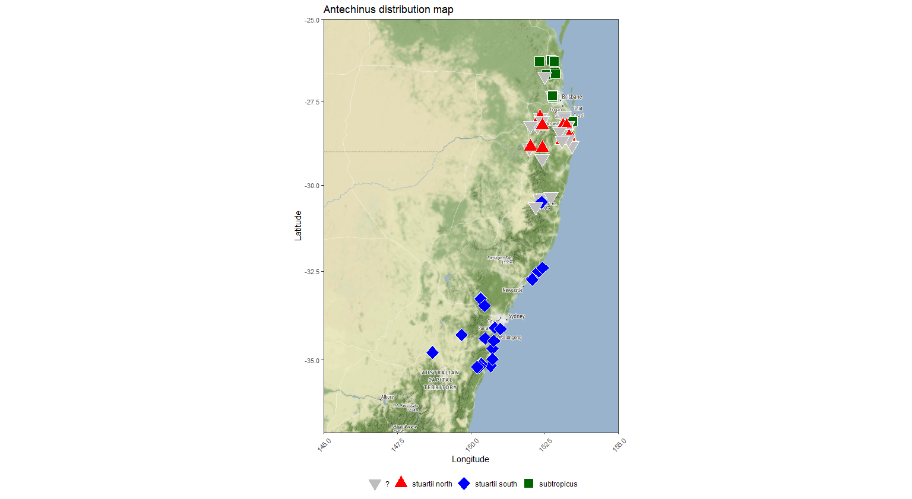
PCA on all specimens, including unknown sex and dubious population identity

Slide 13
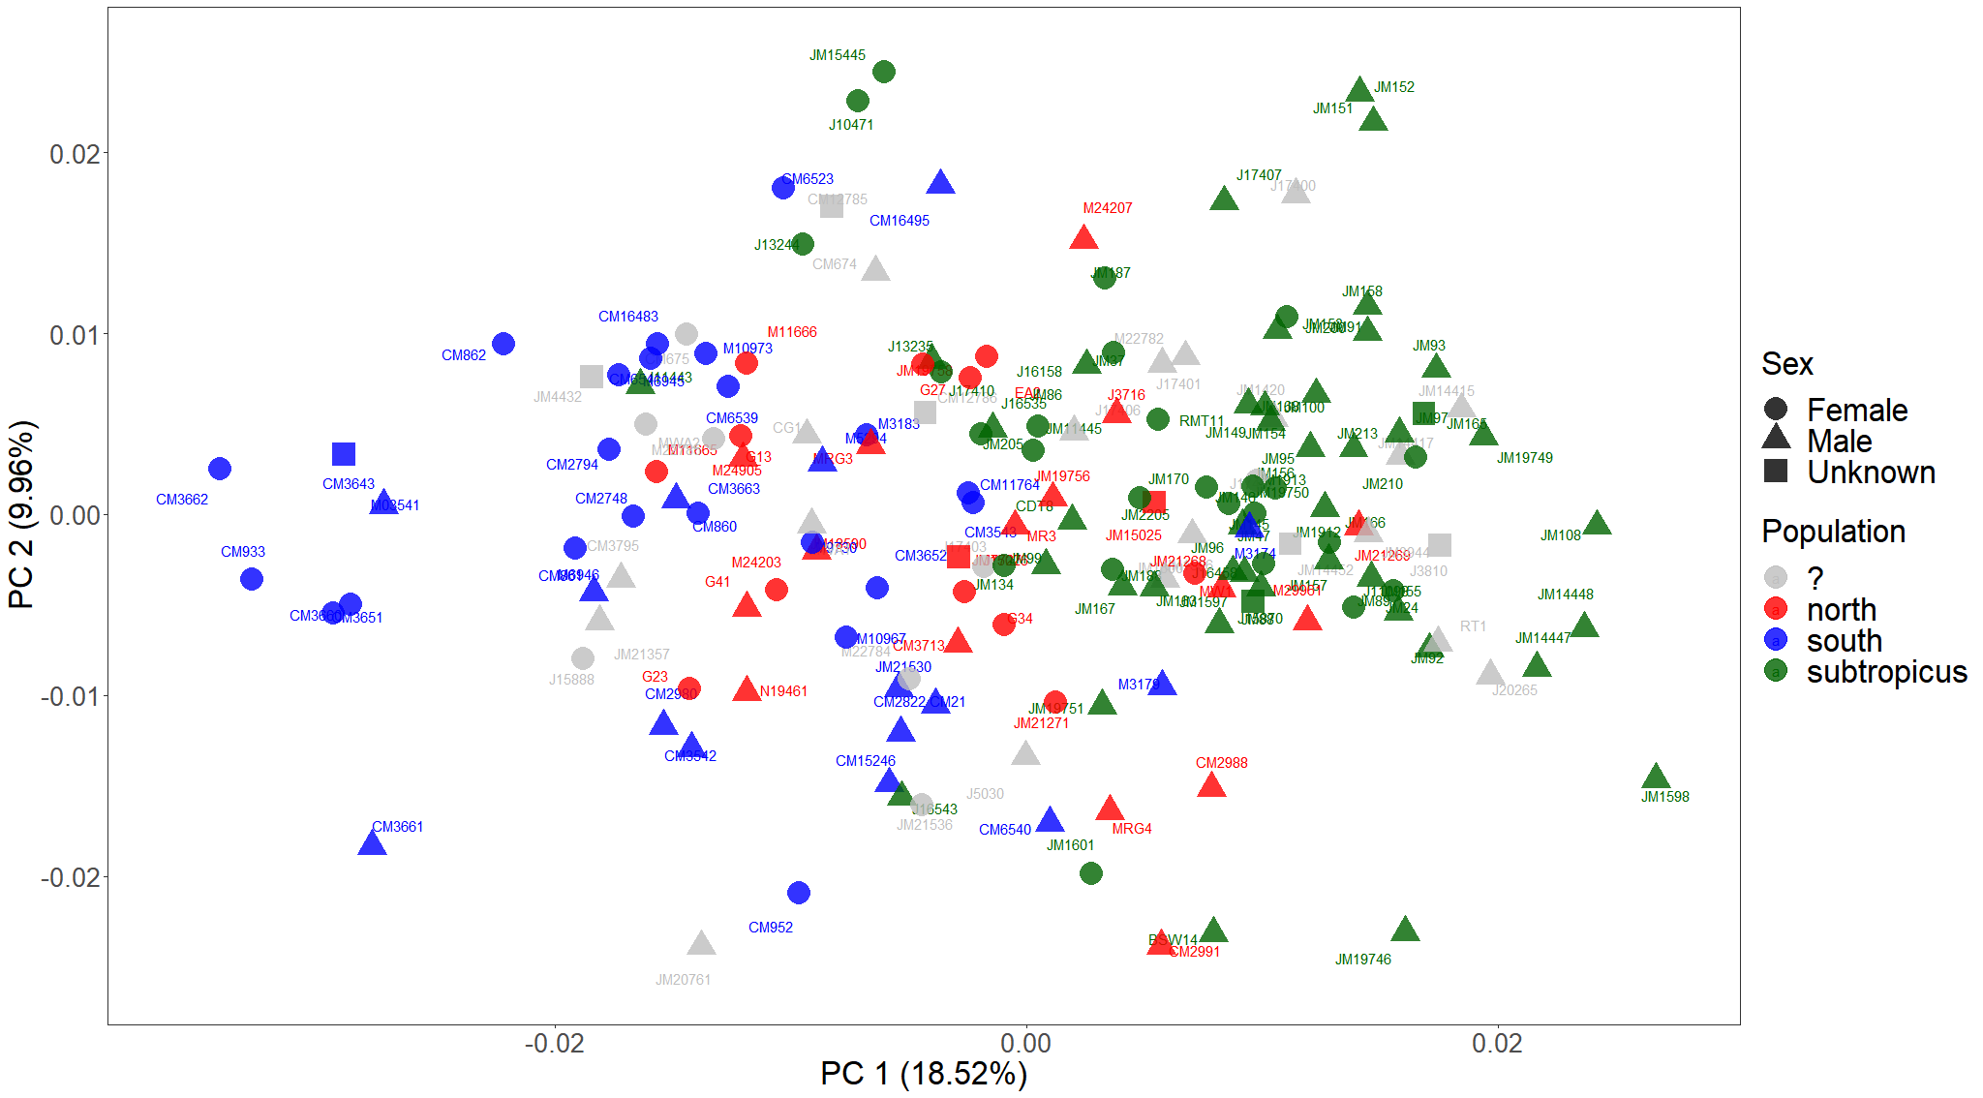
PCA with semilandmarks

Slide 14
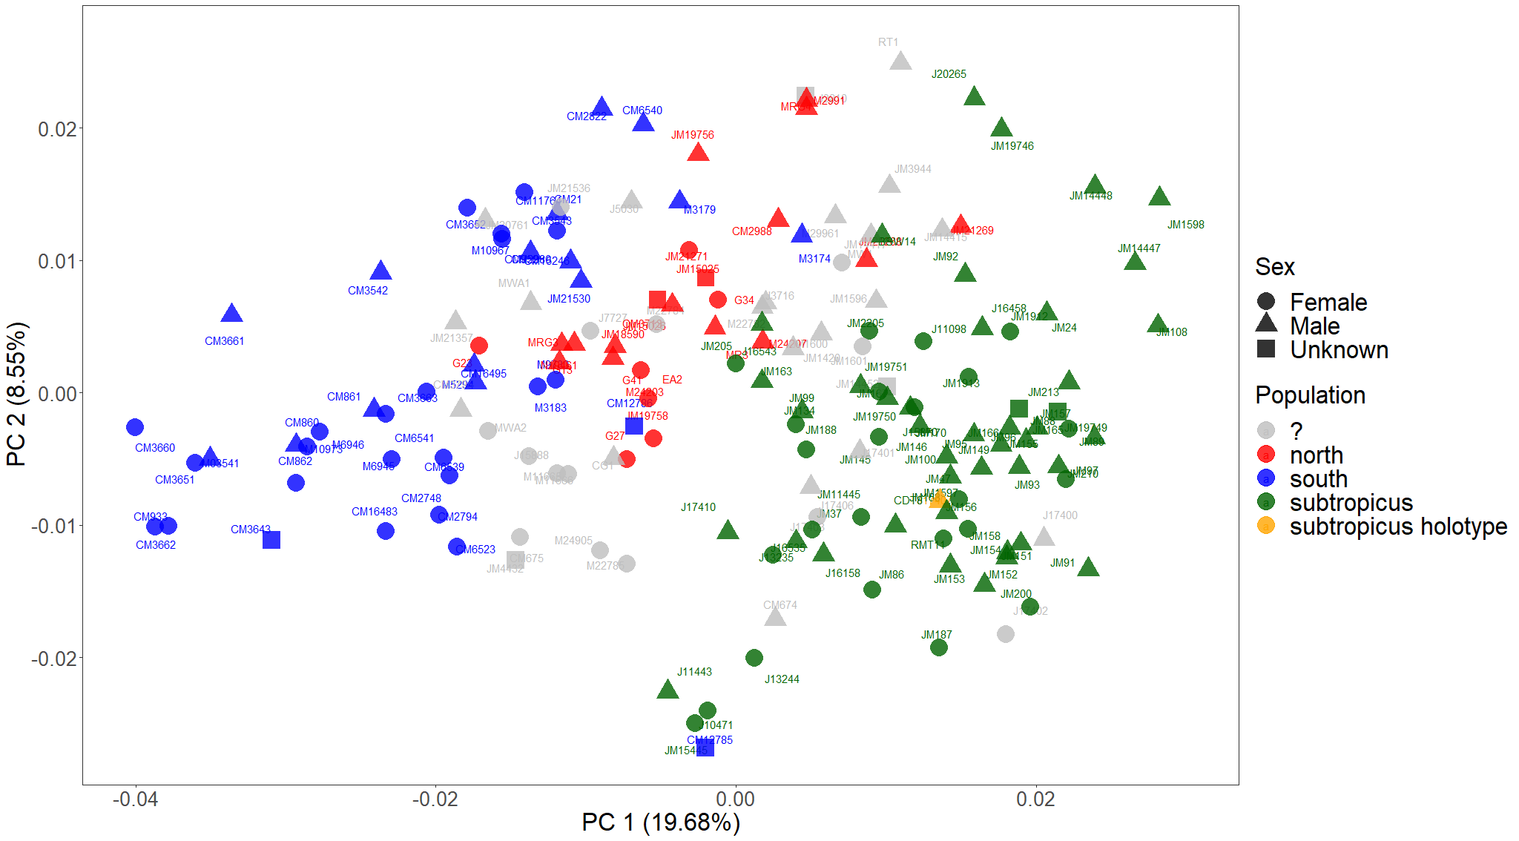

Slide 15
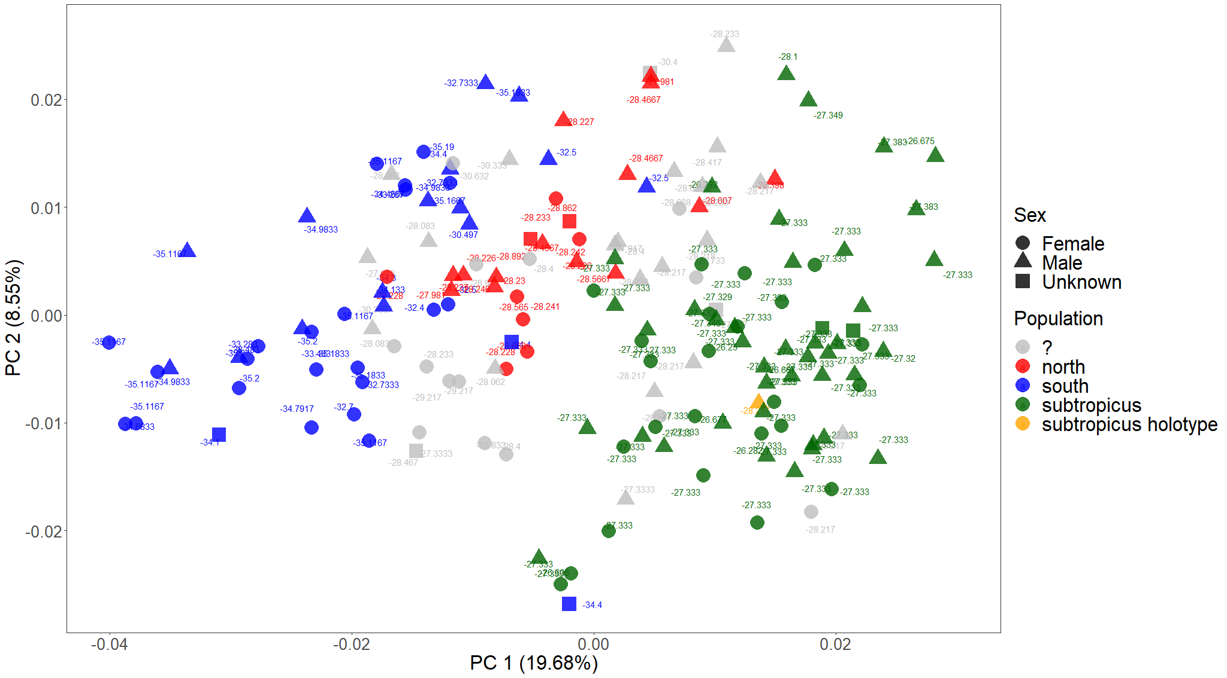

Slide 16
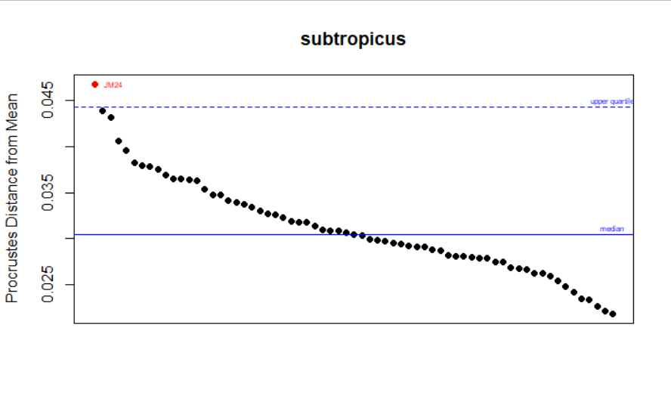
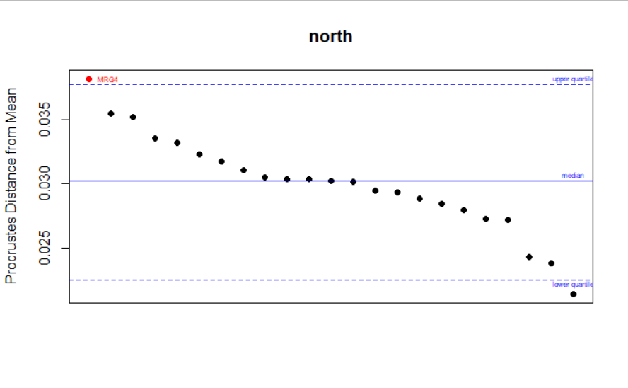
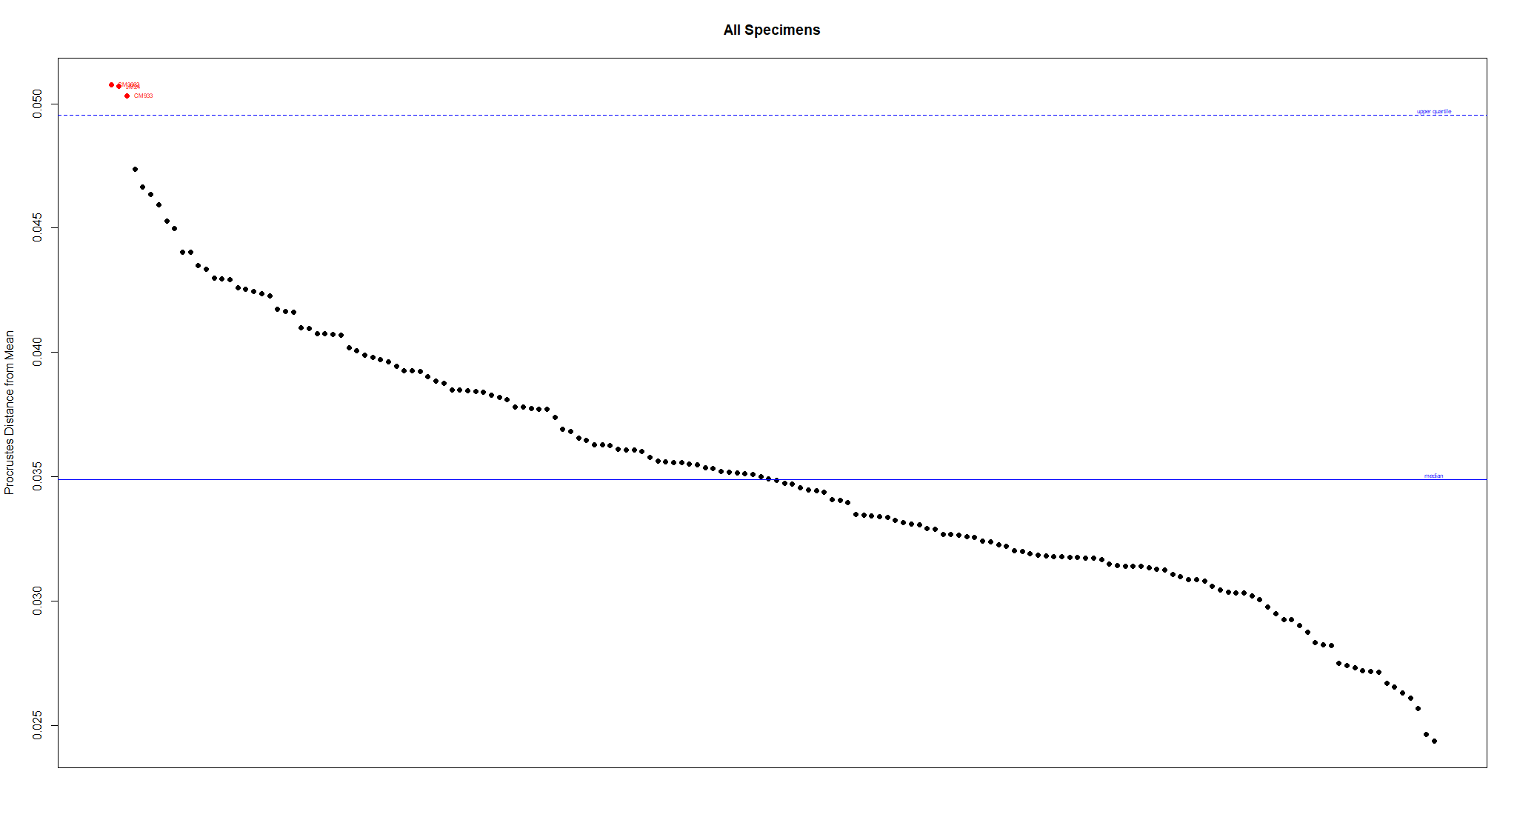

Slide 17
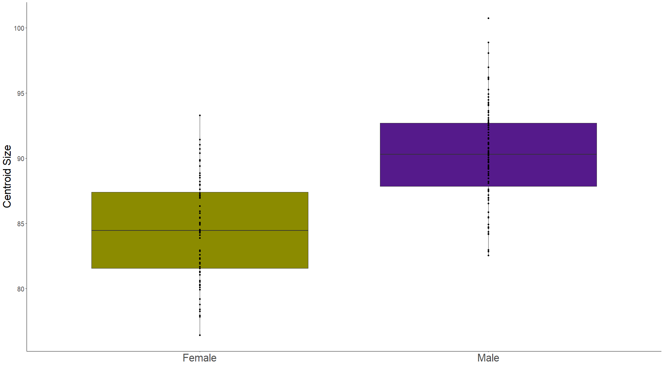
Sex as a predictor of size variation
Adj. R² = 0.355
F_{1,157} = 87.92
p < 0.001

Slide 18
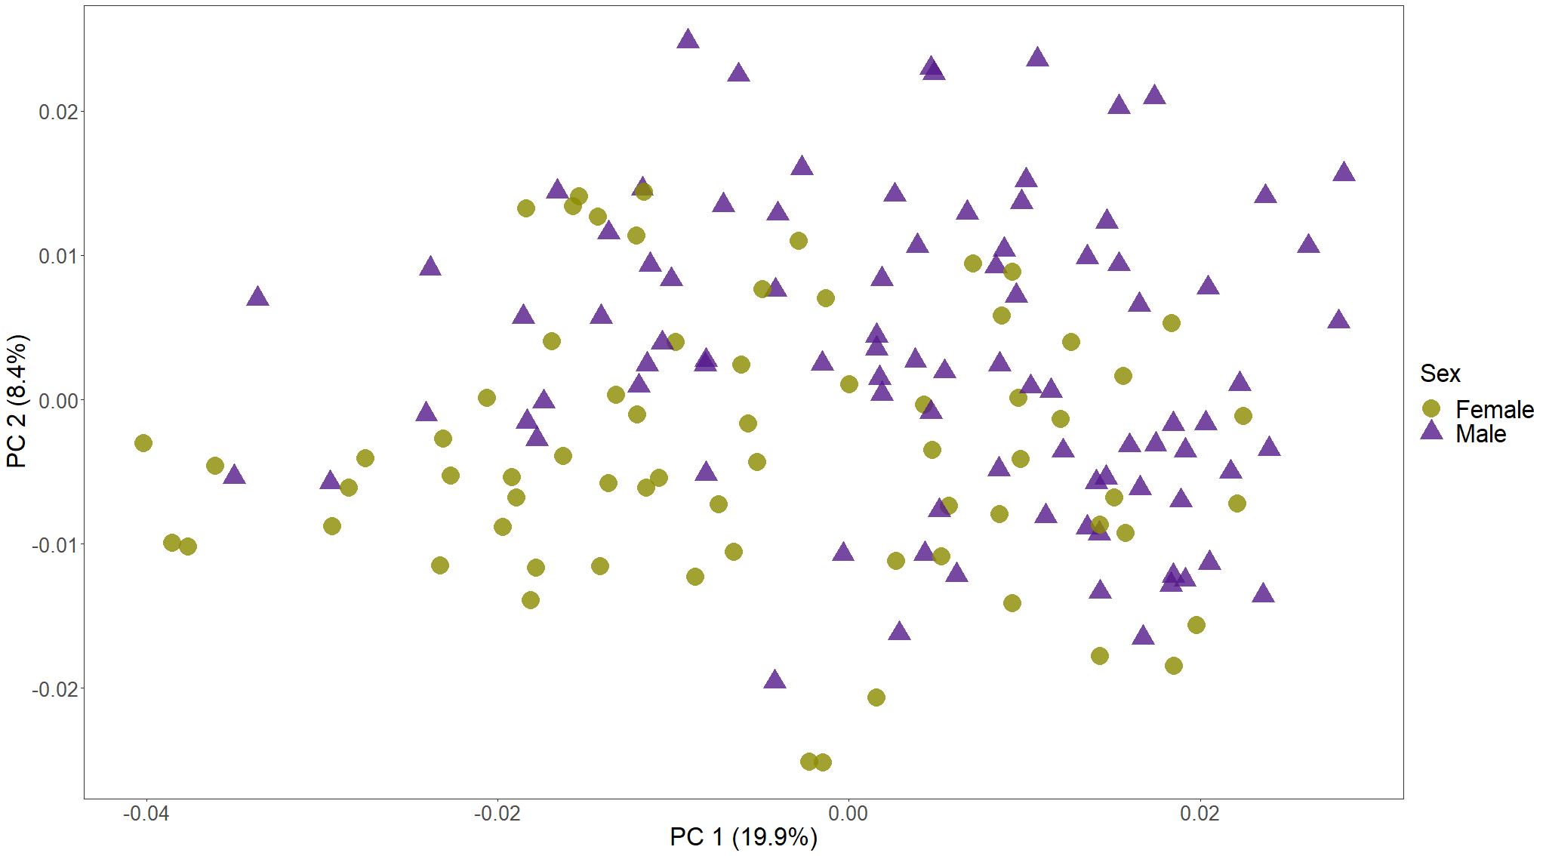
Procrustes ANOVAs
Are sexes different in shape?
(shape~sex)
R² = 0.038
F_{1, 157} = 6.197
p = 0.001
Do they have unique allometries? (shape~size*sex)
R² = 0.005
F_{1, 155} = 0.919
p = 0.556
Adjusting for size, are sexes different in shape? (shape~size+sex)
R² = 0.014
F_{1, 156} = 2.451
p = 0.003
PCA on all specimens, labelling only sex

Slide 19
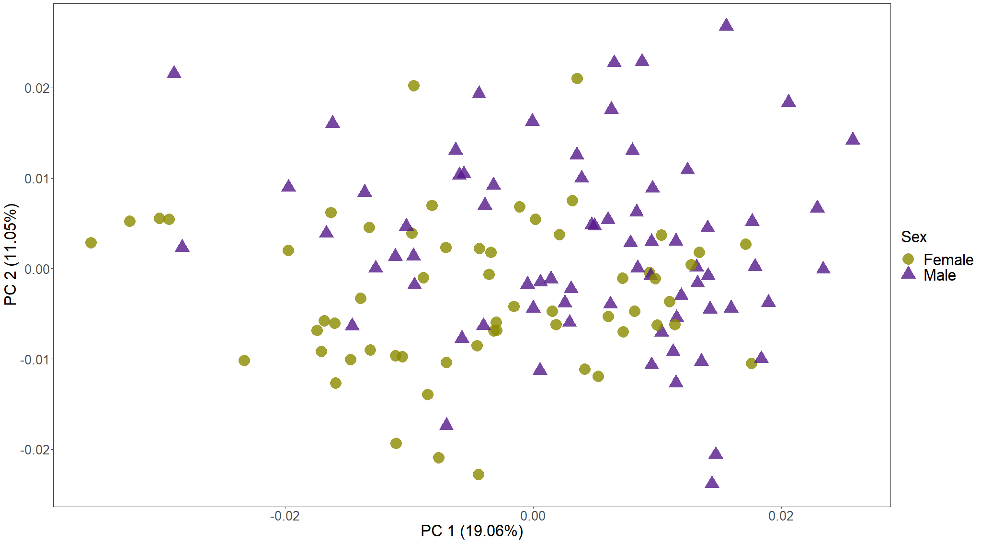
with semilandmarks
Procrustes ANOVAs
Are sexes different in shape?
(shape~sex)
R² = 0.038
F_{1, 157} = 5.051
p = 0.001
Do they have unique allometries? (shape~size*sex)
R² = 0.006
F_{1, 155} = 0.907
p = 0.553
Adjusting for size, are sexes different in shape? (shape~size+sex)
R² = 0.015
F_{1, 156} = 1.946
p = 0.015
PCA on all specimens, labelling only sex

Slide 20
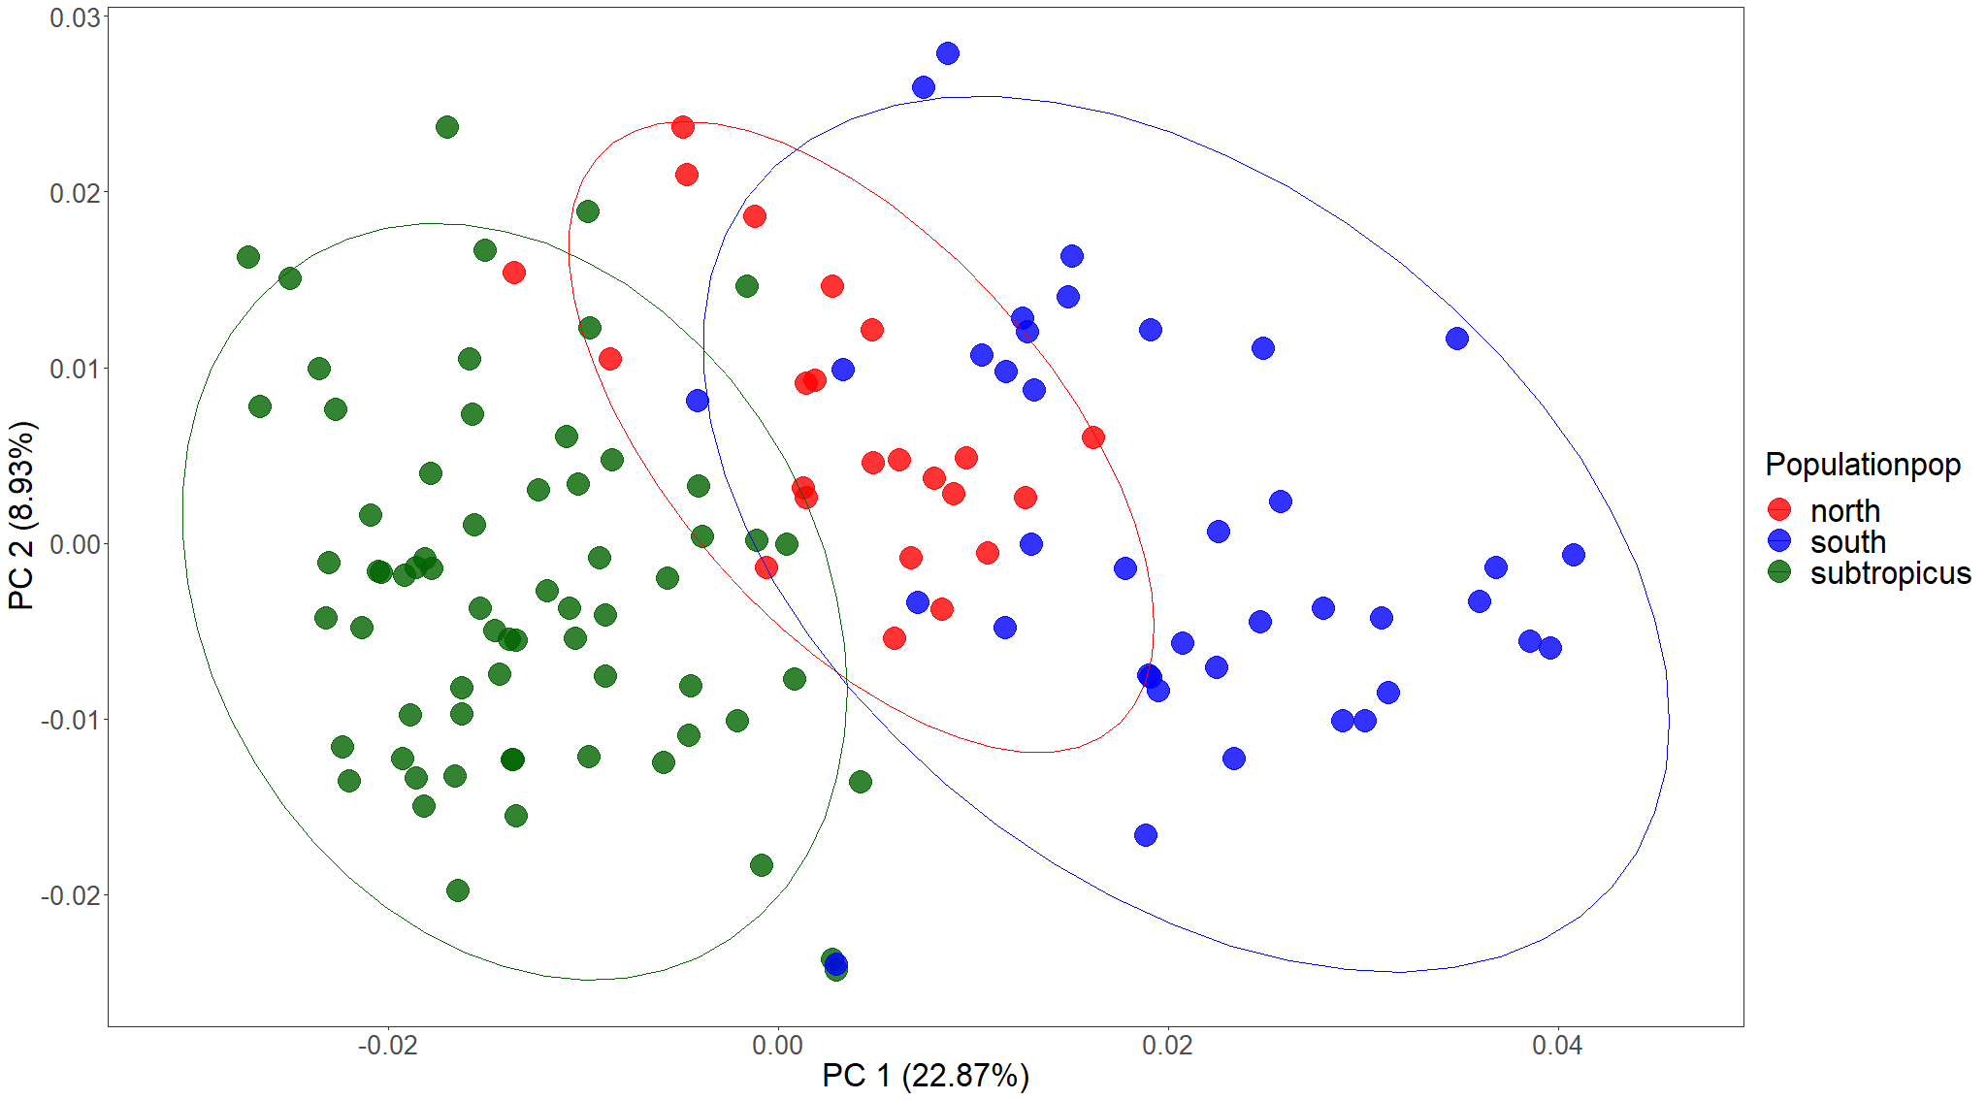
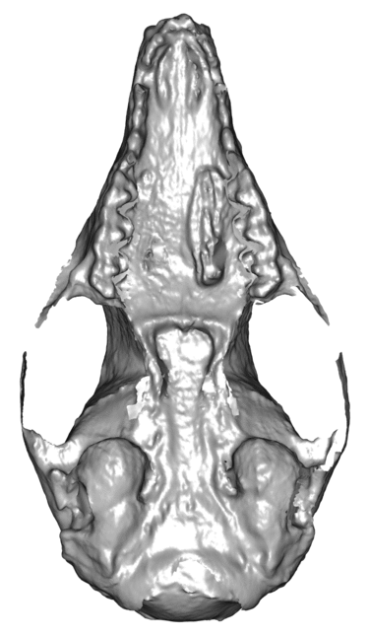
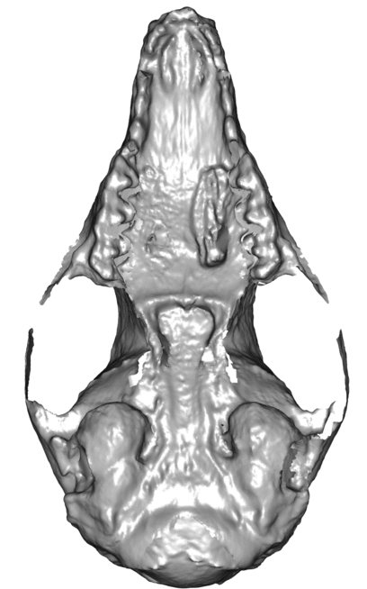
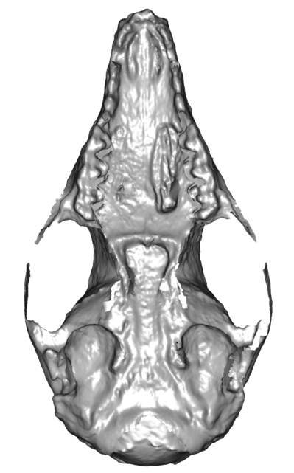
 | south | north | subtropicus
south
north | Mean shape: p = 0.001 Disparity: p = 0.058
subtropicus | Mean shape: p = 0.001 Disparity: p = 0.183 | Mean shape: p = 0.001 Disparity: p = 0.3
Procrustes ANOVA
Are populations different in shape? (shape~population)
R² = 0.202
F_{1, 127} = 15.9
p = 0.001

Slide 21
Response variable | Predictor variable | Question | SS | R² | F | Pr (>F) | Interpretation
Size | Latitude | Is latitude covarying with size in this dataset? | 717.86 | 0.262 | 45.138 | 0.001 | Clear effect.
 | Latitude within each population | Is latitude covarying with size within each population? | South: 19.45 North: 4.11 Sub: 4.61 | South: 0.033 North: 0.012 Sub: 0.005 | South: 1.254 North: 0.259 Sub: 0.341 | South: 0.294 North: 0.62 Sub: 0.582 | No clear effect.
 | Longitude | Is longitude covarying with size in this dataset? | 681.95 | 0.249 | 42.131 | 0.001 | Clear effect.
 | Longitude within each population | Is longitude covarying with size within each population? | South: 4.79 North: 59.92 Sub: 20.22 | South: 0.008 North: 0.178 Sub: 0.023 | South: 0.301 North: 4.53 Sub: 1.524 | South: 0.579 North: 0.043 Sub: 0.224 | No clear effect. North might have a biased sample.
Shape | Latitude | Is latitude covarying with shape in this dataset? | 0.027 | 0.167 | 25.526 | 0.001 | Clear effect
 | Latitude within each population | Is latitude covarying with shape within each population? | South: 0.003 North: 0.001 Sub: 0.002 | South: 0.072 North: 0.038 Sub: 0.024 | South: 2.874 North: 0.825 Sub: 1.626 | South: 0.001 North: 0.774 Sub: 0.025 | Only south stuartii is varying latitudinally in shape with low effect.
 | Longitude | Is longitude covarying with shape in this dataset? | 0.024 | 0.145 | 21.54 | 0.001 | Clear effect
 | Longitude within each population | Is longitude covarying with shape within each population? | South: 0.003 North: 0.001 Sub: 0.002 | South: 0.068 North: 0.063 Sub: 0.023 | South: 2.683 North: 1.407 Sub: 1.496 | South: 0.001 North: 0.076 Sub: 0.09 | Only south stuartii is varying longitudinally in shape with low effect.

Slide 22
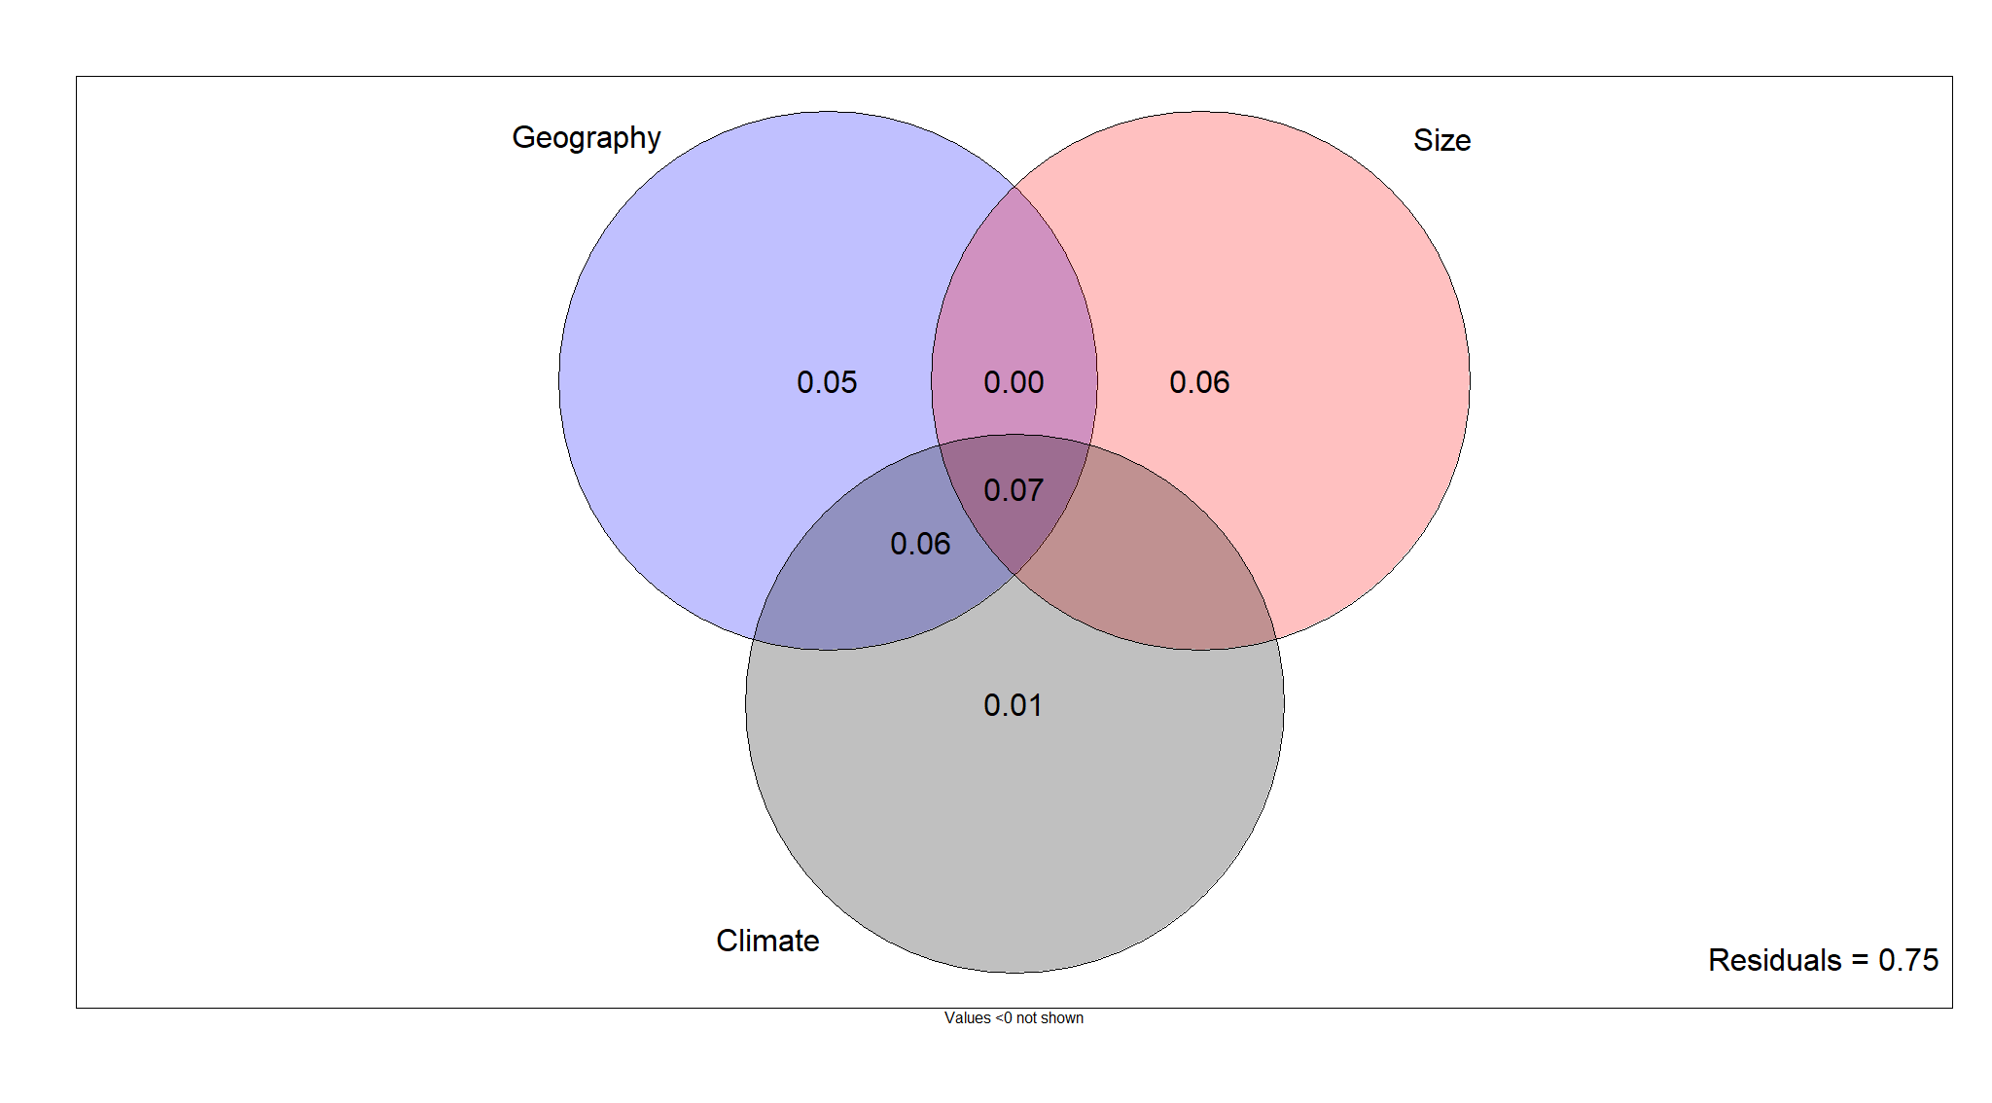
 |  | Size |  |  |  | Shape
 | d. f. | SS | R² | F | Pr(>F) | SS | R² | F | Pr(>F)
Precipitation | 1 | 121.31 | 0.044 | 5.888 | 0.017 | 0.003 | 0.017 | 2.172 | 0.014
Temperature | 1 | 832.91 | 0.304 | 55.53 | <0.001 | 0.023 | 0.138 | 20.294 | 0.001
Elevation | 1 | 60.87 | 0.022 | 2.888 | 0.092 | 0.002 | 0.011 | 1.413 | 0.1
Distance to permanent water | 1 | 246.26 | 0.09 | 12.55 | 0.001 | 0.012 | 0.072 | 9.829 | 0.001

Slide 23
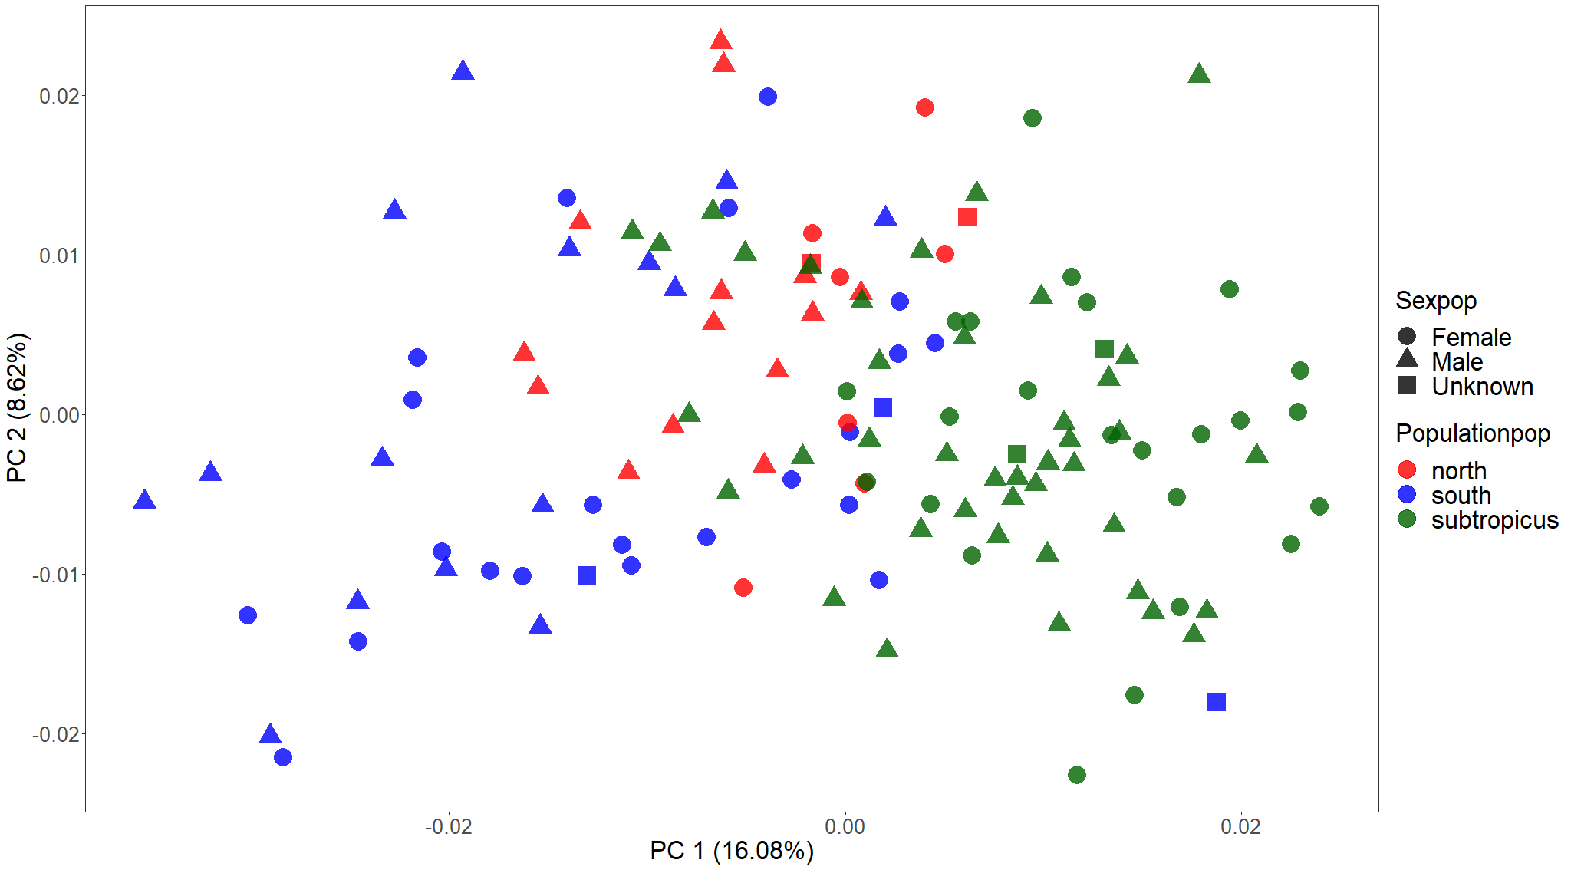
Residual shape PCA

Slide 24
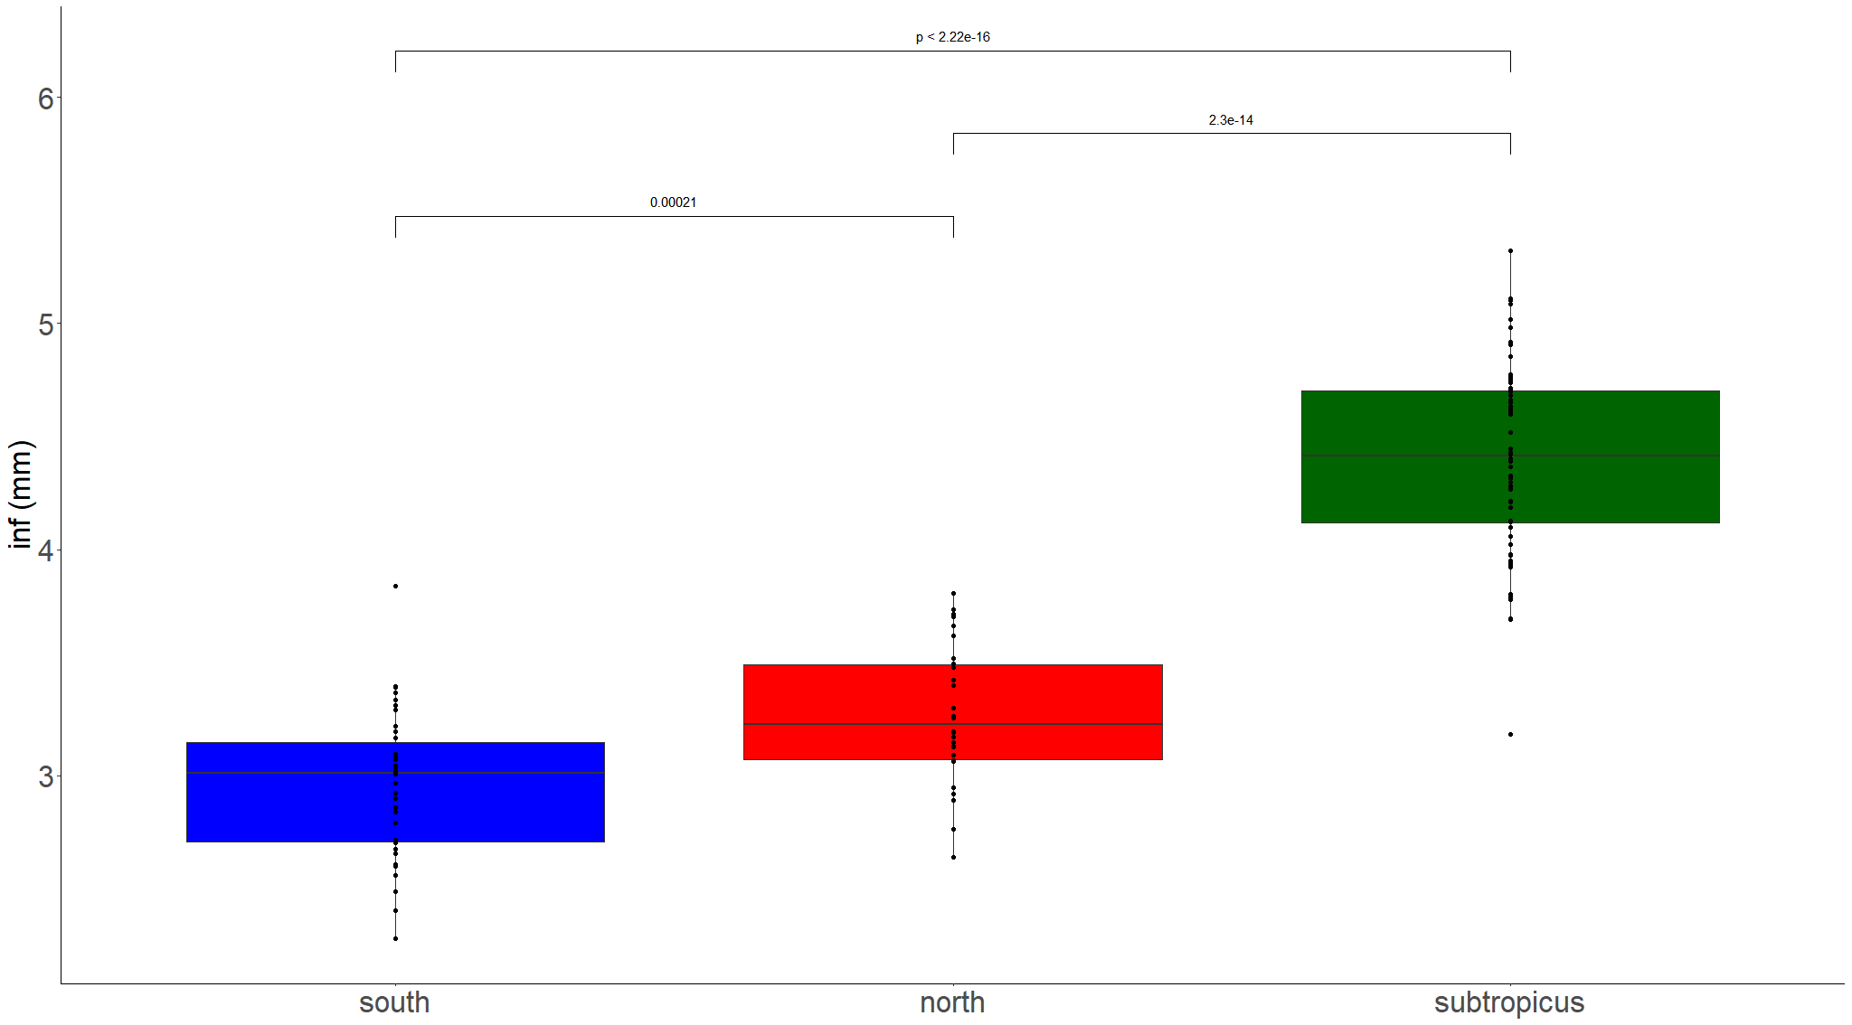

Slide 25
